Slide 1
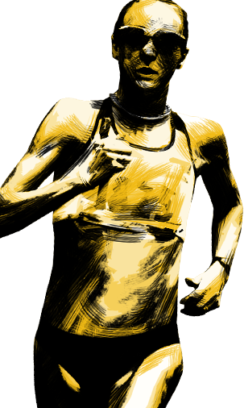
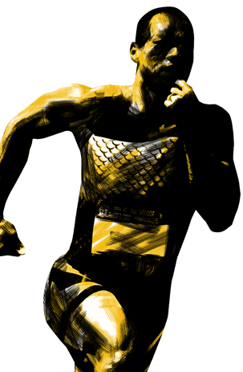
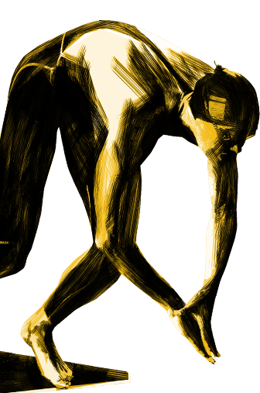
R045
SPORTS NUTRITION
LO¹
Know about the nutrients needed for a healthy, balanced diet

Slide 2
Enquiry question
What nutrients do you think are important for a healthy, balanced diet?
Title LO1: Know about the nutrients needed for a healthy, balanced diet
P | M | D/D*
Identifies some of foods that make a balanced diet. Descriptions are limited when describing what nutrients are and their role within a healthy balanced diet. A limited range of examples of food types are given | Briefly describes most of the foods that make a balanced diet. Describes are detailed when describing what nutrients are and their role within a healthy balanced diet. A range of examples of food types are given. | Describes in detail all of the foods that make a balanced diet. Describes in full detail what nutrients are and their role within a healthy balanced diet. A wide range of examples of food types are given
NACPE TIPS
Reference work
Where possible, use your own words
Present work clearly
ASSESS YOUR WORK AS YOU COMPLETE IT
No. | Task | P | M | D/D*
1 | Subheading: Definition of nutrients - Define nutrients
2 | Subheading: Balanced diet - Define balanced diet
3 | Subtitle: Types of nutrients
4 | Subheading: Carbohydrates - Explain the types (simple and complex) and role of carbohydrates. Provide a wide range of different examples (simple and complex). How much should be eaten per day? (g/kcal).
5 | Subheading: Fats - Explain the types (saturated and unsaturated) and role of fats. Provide a wide range of different examples (saturated and unsaturated). How much should be eaten per day? (g/kcal).
6 | Subheading: Protein - Explain the types and role of protein. Provide a wide range of different examples. How much should be eaten per day (g/kcal).
7 | Subheading: Fibre - Explain the types (soluble and insoluble) and role of fibre. Provide a wide range of different examples (soluble and insoluble). How much should be eaten per day (g/kcal).
8 | Subheading: Water - Explain the role of water. How much should be consumed per day (ml).
9 | Subheading: Vitamins - Explain the types and role of vitamins. Provide a wide range of examples. How much should be consumed per day (mg)?
10 | Subheading: Minerals – Explain the types and role of minerals. Provide a wide range of examples. How much should be consumed per day (mg)?
WWW | EBI | DRT

Slide 3
R045 – LO1 - Task sheet pt.2
Title LO1: Know about the nutrients needed for a healthy, balanced diet
P | M | D/D*
Identifies some of foods that make a balanced diet. Descriptions are limited when describing what nutrients are and their role within a healthy balanced diet. A limited range of examples of food types are given | Briefly describes most of the foods that make a balanced diet. Describes are detailed when describing what nutrients are and their role within a healthy balanced diet. A range of examples of food types are given. | Describes in detail all of the foods that make a balanced diet. Describes in full detail what nutrients are and their role within a healthy balanced diet. A wide range of examples of food types are given
NACPE TIPS
Reference work
Where possible, use your own words
Present work clearly
ASSESS YOUR WORK AS YOU COMPLETE IT
No. | Task | P | M | D/D*
1 | Subtitle: The importance of a balanced diet
2 | What are the positives of a balanced diet?
3 | What are the negatives of an unbalanced diet?
4 | What is the average amount of calories needed for a male and female?
5 | Which macronutrients are best for endurance sports and why?
6 | Which macronutrients are best for strength based sports and why?
7 | If someone is allergic to dairy and/or gluten what foods could be provided instead?
8 | If someone is a vegetarian what foods could you provide to help maintain protein in their diet?
9 | Find a picture of the eatwell plate and explain what is shows. Include a reference.
WWW | EBI | DRT

Slide 4
R045
SPORTS NUTRITION
LO²
Understand the importance of nutrition in sport

Slide 5
Enquiry question What is the importance of fluid and nutrients in sport?
Title LO2: Understand the importance of nutrition in sport
P | M | D/D*
Outlines the importance of nutrition before, during and after exercise. [1 – 2marks] | Describes the importance of nutrition before, during and after exercise. [4 - 5 marks] | Explains in detail the importance of nutrition before, during and after exercise. [5 - 6marks]
No. | Task | P | M | D/D*
1 | Subtitle: Importance of nutrition before, during and after exercise
2 | Subheading: Before exercise Subheading: Fluid: Explain what types and amounts (ml) of fluids should be consumed BEFORE exercise. When is the best time to drink and why? Subheading: Nutrients: Explain what types and amounts (grams/kcal) of macronutrients should be consumed BEFORE exercise. When is the best time to eat and why?
3 | Subheading: During exercise Subheading: Fluid: Explain what types and amounts (ml) of fluids should be consumed DURING exercise. When is the best time to drink and why? Subheading: Nutrients: Explain what types and amounts (grams/kcal) of macronutrients should be consumed DURING exercise. When is the best time to eat and why?
4 | Subheading: After exercise Subheading: Fluid: Explain what types and amounts (ml) of fluids should be consumed AFTER exercise. When is the best time to drink and why? Subheading: Nutrients: Explain what types and amounts (grams/kcal) of macronutrients should be consumed AFTER exercise. When is the best time to eat and why?

Slide 6
R045 – LO2.2 - Task sheet
Name:
Title LO2: Understand the importance of nutrition in sport
P | M | D/D*
Identifies a small range of different activity types and outlines basic food/fluid needs. Lacks accuracy with matching food/fluid needs to different exercises [1 – 2marks] | Identifies a medium range of different activity types and describes basic food/fluid needs for these. Some accuracy with matching food/fluid needs to different exercises. [4 - 5 marks] | Identifies a large range of different activity types and explains food/fluid needs for these. Accurately matches different food/fluid needs with different exercises. [5- 6marks]
NACPE TIPS
Reference work
Where possible, use your own words
Present work clearly
ASSESS YOUR WORK AS YOU COMPLETE IT
No. | Task | P | M | D/D*
1 | Subtitle: Reasons for the varying dietary requirements of different activity types
2 | Subheading: Endurance exercise -Define endurance exercise and provide examples (marathon runner, footballer, cross country, long distance runner). -Define carbohydrate loading and explain it in a sporting context? -Identify and explain what nutrients/fluids should be consumed before, during and after endurance activities *EBI – Include examples of food they should eat, amounts (g/kcal) and timing of consumption
3 | Subheading: Anaerobic exercise -Define anaerobic exercise and provide examples (100m sprinter, weight lifter, long jumper, hurdler) -Identify and explain what nutrients/fluids should be consumed before, during and after anaerobic activities *EBI – Include examples of food they should eat, amounts (g/kcal) and timing of consumption
4 | Subheading: Strength exercise -Define strength exercise and provide examples (weight lifter, worlds strongest man, rugby) -Identify and explain what nutrients/fluids should be consumed before, during and after strength activities *EBI – Include examples of food they should eat, amounts (g/kcal) and timing of consumption
RESOURCES - Student common – PE – MR L GRAHAM – OCR L2 – R045 – LO2
WWW | EBI | DRT

Slide 7
R045 – LO2.3 - Task sheet
Name:
Title LO2: Understand the importance of nutrition in sport
P | M | D/D*
Briefly describes the use of dietary supplements in sport with little reference to sporting performance. Limited awareness of issues associated with their use [1 – 2marks] | Describes the use of dietary supplements in sport with some reference to sporting performance. Shows some understanding of issues associated with their use [3 - 4 marks] | Describes the use of dietary supplements in sport with detailed reference to sporting performance. Shows well developed understanding of issues associated with their use [5 - 6 marks]
NACPE TIPS
Reference work
Where possible, use your own words
Present work clearly
ASSESS YOUR WORK AS YOU COMPLETE IT
No. | Task | P | M | D/D*
1 | Subtitle: The use of dietary supplements in sport
2 | Subheading: What is a dietary supplement? – define a dietary supplement and explain why they are used.
3 | Subheading: Types of dietary supplements – Explain why a sports person might use each of the following supplements; Protein powders Creatine Multi-vitamins Herbal supplements Include how these supplements are taken (e.g. powder or tablets) and give examples of which sports could benefit from using them.
4 | Subheading: Issues associated with the use of supplements in sport What are the health issues associated with using the above supplements? Are these supplements allowed to be used in sport? Is using dietary supplements in sport classed as cheating?

Slide 8
The use of dietary supplements in sport
Define the term dietary supplement? ____________________________________________________________________________________________________________________________________________________________________________________________________________________________________________________________________________________________________________________________________________________________
Types of dietary supplements
Supplement | Introduction | Issues associated with supplements |  | Sporting example
 |  | Positive effects | Negative effects
Creatine Protein Multivitamins | Definition? Who takes it and why? What forms is it available in? When and how much creatine supplements should you have and why?
 |  | Why is this useful in sport? | Why is this not useful in sport?

Slide 9
R045
SPORTS NUTRITION
LO³
Malnutrition n sport

Slide 10
Title: Malnutrition
Learning Outcome 3: Know about the effects of a poor diet on sports performance and participation
P | M | D/D*
Definition of malnutrition is limited (1 mark). | Definition of malnutrition is accurate with some detail (2 marks). | Definition of malnutrition is accurate and detailed (3 marks).
No. | Task
1 | Subheading: Malnutrition Define the term malnutrition? X 2 internet definitions & one of your own (For example, a condition that results from an unbalanced diet in which some nutrients are lacking/missing). Give two definitions: One referenced from the internet/one definition from your own understanding.
2 | Subheading: Effects and consequences of malnutrition Describe the effects or consequences of malnutrition?
3 | Subheading: Effects of malnutrition on sports performance Choose a sport/sporting athlete and consider how malnutrition can cause some of the following: Stress Fatigue Poor performance Longer recovery times Weight changes

Slide 11
Title: The effects of over-eating on sports performance and participation
Learning Outcome 3: Know about the effects of a poor diet on sports performance and participation
P | M | D/D*
Outlines the effects of over-eating, under-eating and dehydration using limited reference to sports performance and participation. Draws upon limited skills/knowledge/understanding from other units in the specification (1-4 marks). | Describes the effects of over-eating, under-eating and dehydration using some clear reference to sports performance and participation. Draws upon some relevant skills/knowledge/understanding from other units in the specification (5-8 marks). | Explains in detail the effects of over-eating, under-eating and dehydration with clear and specific reference to sports performance and participation. Clearly draws upon relevant skills/knowledge/understanding from other units in the specification (9-12 marks).
No. | Task
1 | Subheading: Overeating Define the term Overeating? Give two definitions: One referenced from the internet/one definition from your own understanding.
2 | Subheading: Effects of overeating on sports performance and participation (Consider the following) If you are overweight your fitness will deteriorate (e.g. your flexibility, agility and stamina will decrease) You lose confidence and become anxious about participating You can develop a range of illnesses (e.g. high blood pressure, arthritis, diabetes) which prevent you from participating in certain activities Eating large amounts immediately before participating in a sports activity can make you feel sick during participation Can lead to obesity
3 | Choose a sport/sporting athlete and consider how overeating has impacted their performance? E.G Andy Reid, Tyson Fury, Lee Westwood.
Relate each of these to a sporting situation

Slide 12
Title: The effects of under-eating on sports performance and participation
Learning Outcome 3: Know about the effects of a poor diet on sports performance and participation
P | M | D/D*
Outlines the effects of over-eating, under-eating and dehydration using limited reference to sports performance and participation. Draws upon limited skills/knowledge/understanding from other units in the specification (1-4 marks). | Describes the effects of over-eating, under-eating and dehydration using some clear reference to sports performance and participation. Draws upon some relevant skills/knowledge/understanding from other units in the specification (5-8 marks). | Explains in detail the effects of over-eating, under-eating and dehydration with clear and specific reference to sports performance and participation. Clearly draws upon relevant skills/knowledge/understanding from other units in the specification (9-12 marks).
No. | Task
1 | Subheading: Under-eating Define the term Under-eating? Give two definitions: One referenced from the internet/one definition from your own understanding.
2 | Subheading: Effects of under-eating on sports performance and participation (Consider the following) You will have less energy (e.g. not taking in enough carbohydrates) and tire quickly Your muscles and bones weaken, increasing the risk of injury Your concentration becomes impaired, lack of focus in performance. You may develop an eating disorder (e.g. anorexia) and train too hard leading to injury and/or illness You may develop an illness which prevents you from participating (e.g. kidney infections)
3 | Choose a sport/sporting athlete and consider how under-eating has impacted their performance? E.G Andy Foreman,
Relate each of these to a sporting situation

Slide 13
Title: The effects of dehydration on sports performance and participation
Learning Outcome 3: Know about the effects of a poor diet on sports performance and participation
P | M | D/D*
Outlines the effects of over-eating, under-eating and dehydration using limited reference to sports performance and participation. Draws upon limited skills/knowledge/understanding from other units in the specification (1-4 marks). | Describes the effects of over-eating, under-eating and dehydration using some clear reference to sports performance and participation. Draws upon some relevant skills/knowledge/understanding from other units in the specification (5-8 marks). | Explains in detail the effects of over-eating, under-eating and dehydration with clear and specific reference to sports performance and participation. Clearly draws upon relevant skills/knowledge/understanding from other units in the specification (9-12 marks).
No. | Task
1 | Subheading: Dehydration Define the term dehydration? Give two definitions: One referenced from the internet/one definition from your own understanding.
2 | Subheading: Effects of dehydration on sports performance and participation (Consider the following) You can overheat leading to heat stroke Your concentration becomes impaired You will tire more quickly You become ill during participation (e.g. vomiting) Can cause cramp/lactic acid build up Can affect endurance activities
3 | Choose a sport/sporting athlete and consider how dehydration has impacted their performance? E.G Alonso (F1 driver) Paula Radcliffe, Football players in World Cup (hot countries), tennis players
Relate each of these to a sporting situation

Slide 14
R045
SPORTS NUTRITION
LO⁴
Devising a diet plan sport

Slide 15
Subheading 1 : Profile
Name: Mr L. Graham
Age: 39
Gender: Male
Allergies: N/A
Religious beliefs: N/A
Food budget: £200 per month
Weight: 75kg
Recommended kcal non exercise day: 2500kcal
Recommended kcal exercise day: 3500kcal
Cooking skill: Parents cook/I cook/No cooking skills
Type of activity: Football/Basketball/etc

Slide 16
Subheading 2: Diet plan design
Aims of the diet plan: What are your aims for the diet plan? Consider losing weight, gaining stamina, having more energy to play sport, increasing muscle mass.
Set realistic goals that can be measured: To play a game of football/sport without feeling tired/slow…recover quicker after football….to improve my overall 5k time….lose 2 pounds per week…improve my BMI…measure arms/thighs/waist
Time of year: Is the performer training for an event? Is it off season? What fruit and vegetables are available at that time of year?
Duration of diet plan: How long will the diet plan last for?
Organisation of diet plan: What are the meals involved in a day? What is the break between your meals and why? Will the diet plan organisation change, if so why? Will your diet plan include fluids if so why? Will any supplements be provided, if so why?

Slide 17
Subheading 3: 2 week diet
Create a 2 week diet plan which suits aims of client
Range of micro and macro nutrients that are suited to client
Breakfast, lunch, dinner, fluids, snacks am/pm, supplements
Must include amounts
Carefully consider amounts and types of food before, during and after exercise. This will help your justification.
State next to day whether it is a game day/training day/rest day.

Slide 18
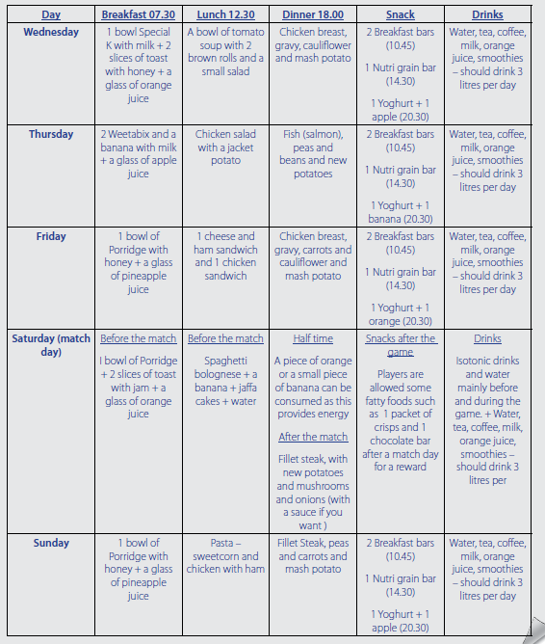
Example week

Slide 19
Subheading 4: Suitability of the diet plan
Task: Justify the type, timing and amount of Carbohydrate, protein, fats and micro nutrients (vitamins and minerals and fibre) provided for each meal of the day and why?
Why have you chose those particular meals, for those days? Relate it to whether your client is resting, training or playing a game.
Breakfast:
Lunch:
Dinner:
Snacks (AM/PM)
Fluids:
Supplements (If you’ve included them in your diet):
See example below:

Slide 20
Subheading 5: Objective evaluation of diet plan
Objective measures (Create a table)
Weight - Before and after
Speed - Before and after
Distance - Covered before and after
Week 1 and 2 diary
Create a scoring scale (i.e. use emoji faces to show good/ok/poor)
Weekly journal (WWW/EBI in week 1/2). Consider food/fluid likes dislikes. How they felt after each day?
 | Before | After
Weight
BMI
Endurance (Bleep test)
Speed (30m sprint)
Week 1 (Days) | Scoring scale | Comment
Monday |  | I felt I needed more fluid because I became dehydrated towards the end of the day.
Tuesday
Wednesday
Thursday
Friday
Saturday
Sunday
Week 2 (Days) | Scoring scale | Comment
Monday
Tuesday
Wednesday
Thursday
Friday
Saturday
Sunday

Slide 21
Subheading 6: Subjective evaluation of diet plan
Subjective methods (Interview questions)
Think of 5 questions to ask your client based on the 2 week diet plan you have just put in place (You can use some of the questions below).
Record their answer under each of the questions.
Some example;
Do you feel the diet plan was long enough?
Did you stick to the programme or did you at times have a cheat meal?
Were the portion sizes big enough?
Are you able to train more and do you find training easier now?
Did the timings of meal suit to the needs of your day?
Do you feel the rest day meals helped you recover after training?
Did you consume enough fluid over the two weeks and did you see a difference in the way you felt?
Were there any meals you didn’t enjoy?
Do you feel you have improved in your performance?

Slide 22
Subheading 7: Areas for improvement
You must relate this to the Interview questions and the 2 week diary. Show that you can reflect on what your client has said.
Consider the following:
Increase the duration of the diet plan
Include more spices in the food cooked
Regular snacks
Learn new recipes
Daily challenges
Increase the number of meals in a day
Increase/decrease portion sizes.
Include supplements
Change the timings that you eat to suit you
Set daily targets to drink so much fluid

