Slide 1
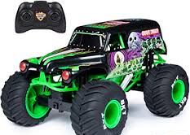
Task 1- Product Analysis
Task: Conduct a product analysis on this remote-control car. Use the questions below to help you and the materials and processes knowledge organiser attached to the assignment to help you.
Aesthetics- Why has the colour scheme been used? How have the graphics been applied
Customer- What sort of person might want this product? Why do you think this? Who will buy it?
Cost- What do you think this product will cost (or find out)? What are the major costs of making this item?
Environment- What sort of environment will this item operate/be kept in? How does this affect design thinking?
Safety- Is this a safe product? How has it been made as safe as possible?
Size- The truck is 30cm long, 25cm wide and 20cm high. Is this a suitable size? Why?
Function- Which features help the truck work like it's supposed to?
Materials- Which materials have been used? Why are they suitable?
Manufacture- How have the materials been shaped and joined? why have these methods been chosen?

Slide 2
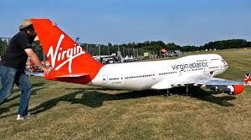
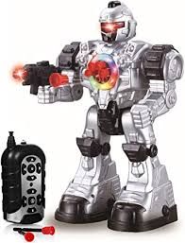
Task 2- Creative Design
Task: Design a remote-control vehicle of your own. It could be a vehicle for a certain type of ground or for something useful like filming.
Draw 3 different ideas and add colour to show them in a realistic state.
When you are finished drawing, label your ideas to explain the why you have made each feature like you have.
USE THE LABELLING GUIDE AND THE KNOWLEDGE ORGANISER ON ATTACHED TO THE ASSEIGNMENT TO HELP YOU.

Slide 3
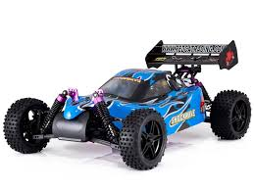
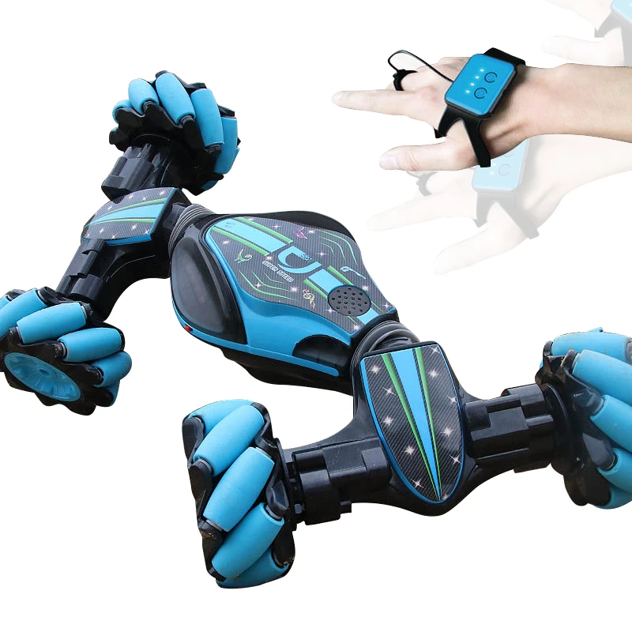
Task 3- Evaluation
Use the same criteria as on task 1 to COMPARE these two R/C car designs.
Which one is best, or do they both have their merits? What/who is each more suited for? Consider:
Looks
Customer
Cost
Environment
Safety
Size
Function
Materials
Manufacture

Slide 4
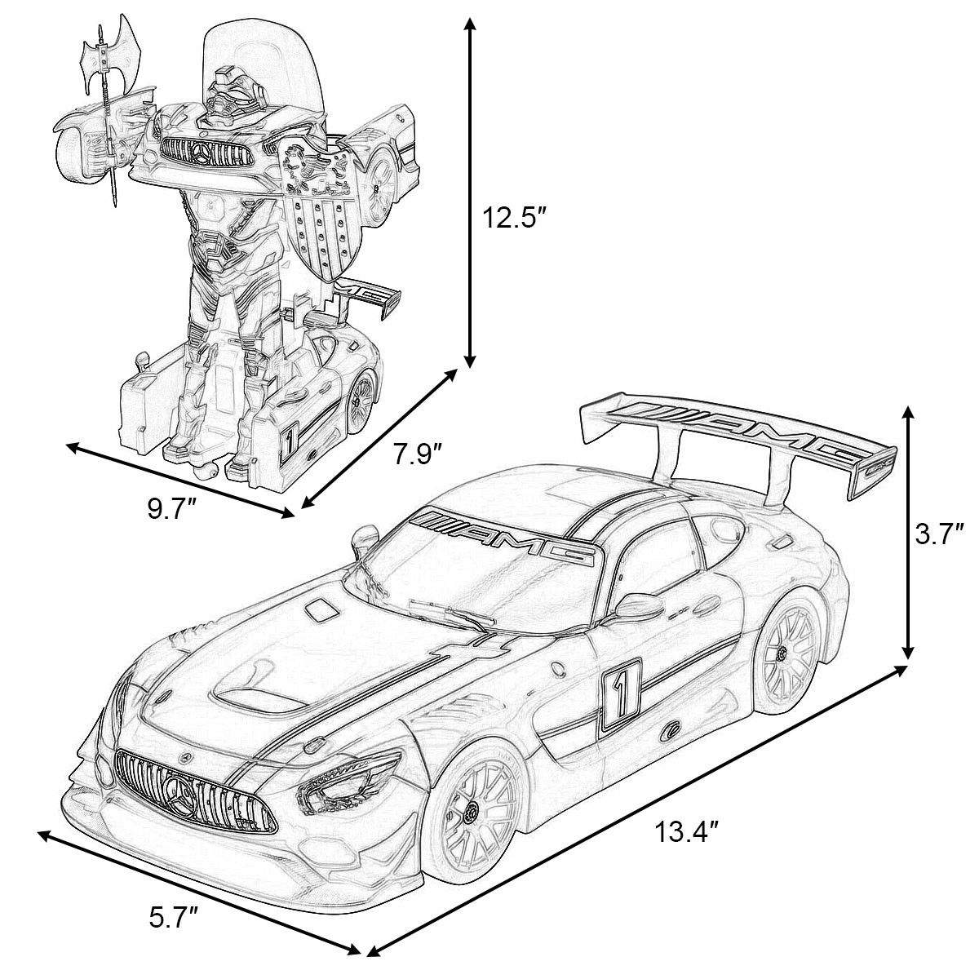
Task 4- Technical Drawing
Task: try and draw the car opposite in a technical drawing format. It will help if you have a set square and a compass, but as long as you have a pencil and ruler you should be able to do it.
1- Draw the car in 3D Isometric projection, like the left-hand example. The guidelines should be at 30° to the bottom of the page. All vertical lines stay vertical.
2- draw the car in orthographic projection. This means drawing it from the front, side and top, lining the views up as in the right-hand example.

