Slide 1
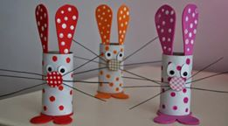
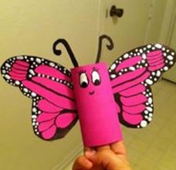
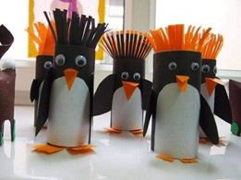
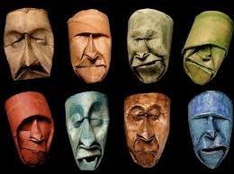
Loo Roll Art Challenge
Two challenges in one: an art drawing challenge and an art 3D challenge, do one, both, or mix the two!

Slide 2
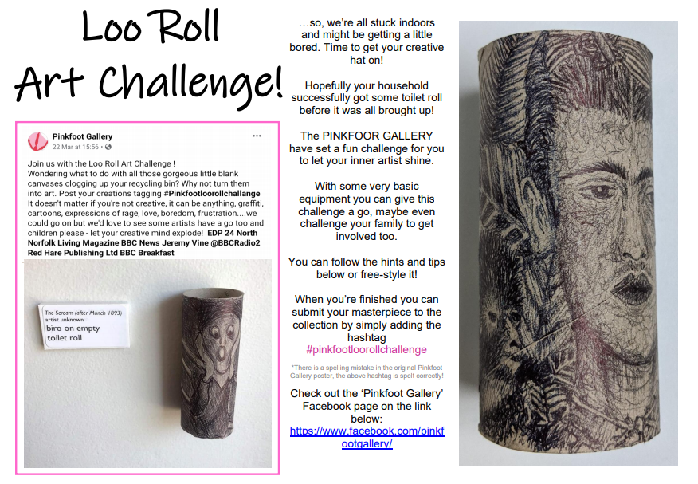

Slide 5
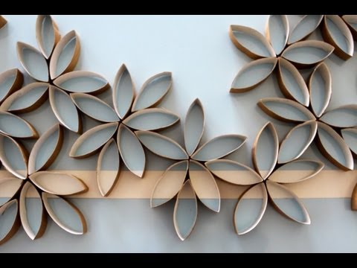
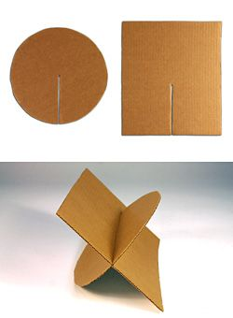
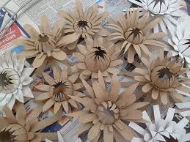
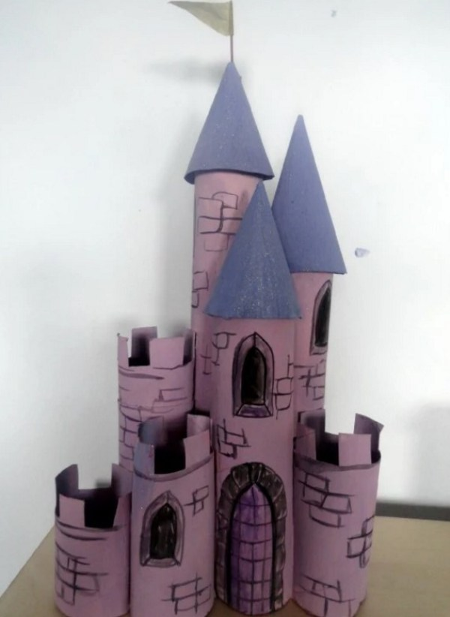
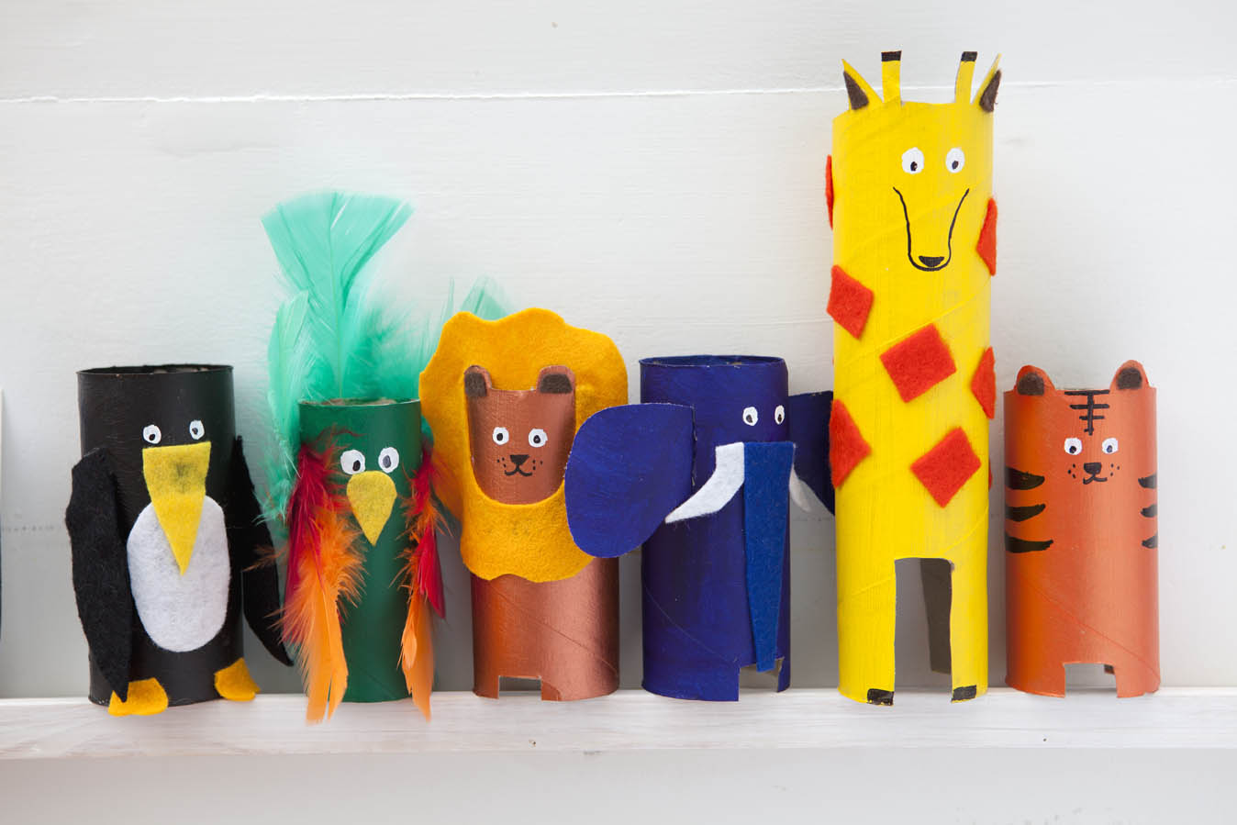
Loo Roll Art 3D Challenge
Google search ‘things made from toilet rolls’ or ‘3d art made from toilet rolls’ or ‘sculpture made from toilet rolls’ for inspiration and some instructions, or, just use your own creativity.
If you do not have glue, remember you can cut slots to join card together.
Maybe make this a challenge with your family?
Have fun and I would love to see results.

