Slide 1
Year 8
African Art
Booklet
NAME
CLASS
TEACHER

Slide 2
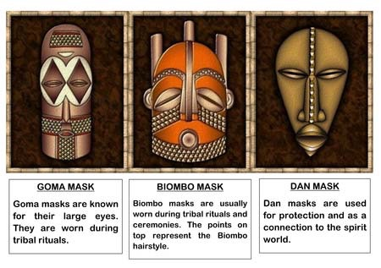
Pattern
What is a pattern?
…………………………………………………………………………………………….…….…………..………………………………………………………………………………………..........................
Where could you find a pattern in your home?
…………………………………………………………………………………………….…….…………..……………………………………………………………………………………………………………….
What kind of shapes are used in traditional African Pattern?
…………………………………………………………………………………………….…….…………………………………………………………………………………………………..
What key colours are used in traditional African Art?
…………………………………………………………………………………………….…….…………..……………………………………………………………………………………………………………….
What were African masks used for?
………..…………………………………………………………………………………….…….…………………..……………………………………………………………………………..…………………………………………………………………………………………….…………………………………………

Slide 3
Design your own African mask using light pencil line in the box below. Add some colour to your design.

Slide 4
Careers in Art Word Search
Teacher Curator Photographer
Cartoonist Artist Illustrator
Games Designer Historian Architect
Stylist Fashion Designer Decorator
Ceramicist Art Therapist Interior Designer
Web Designer Jewellery Designer Makeup Artist
Painter Sculptor Printmaker
Set Designer Footwear Designer

Slide 6
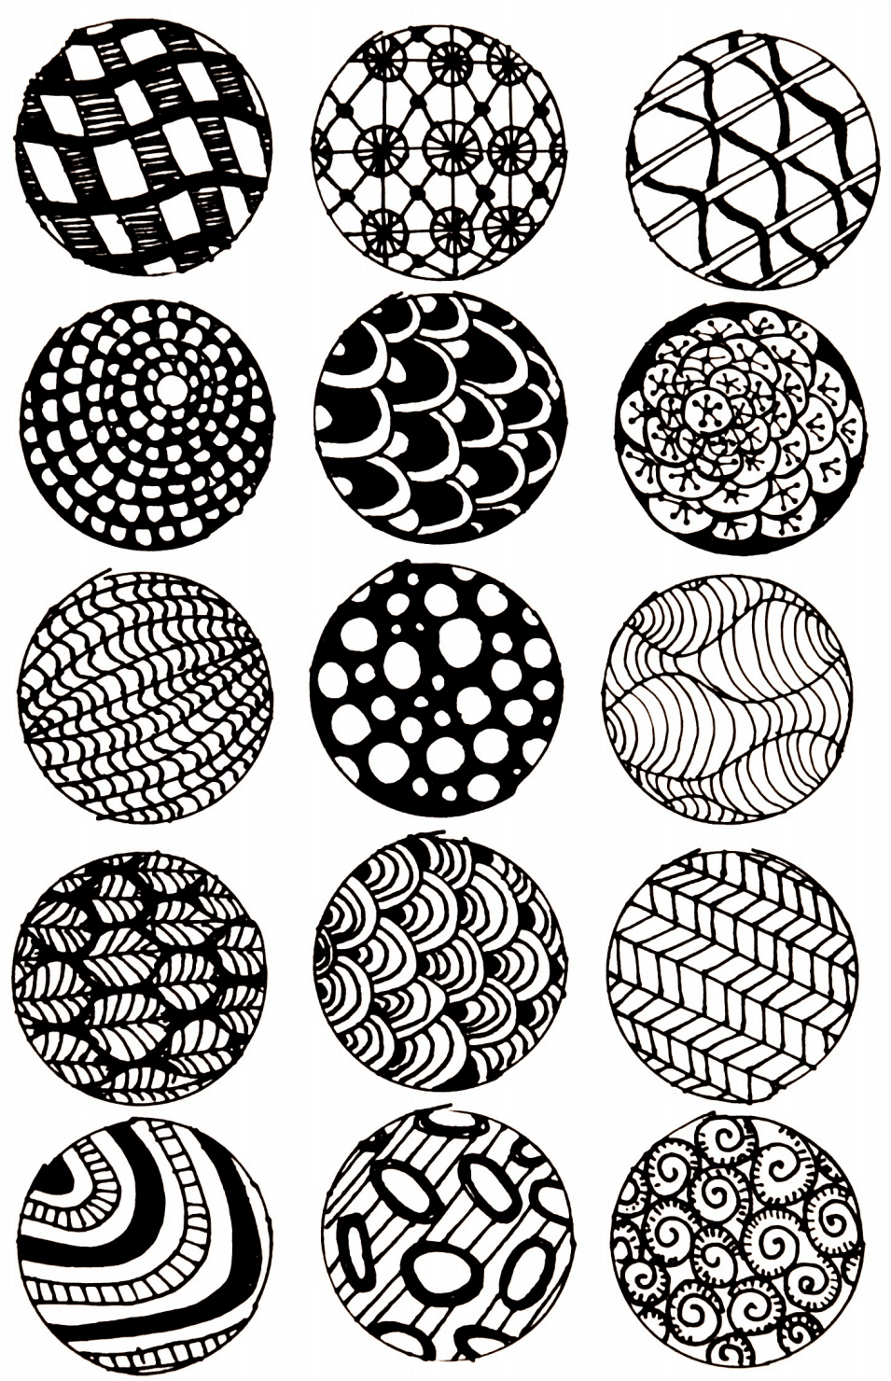
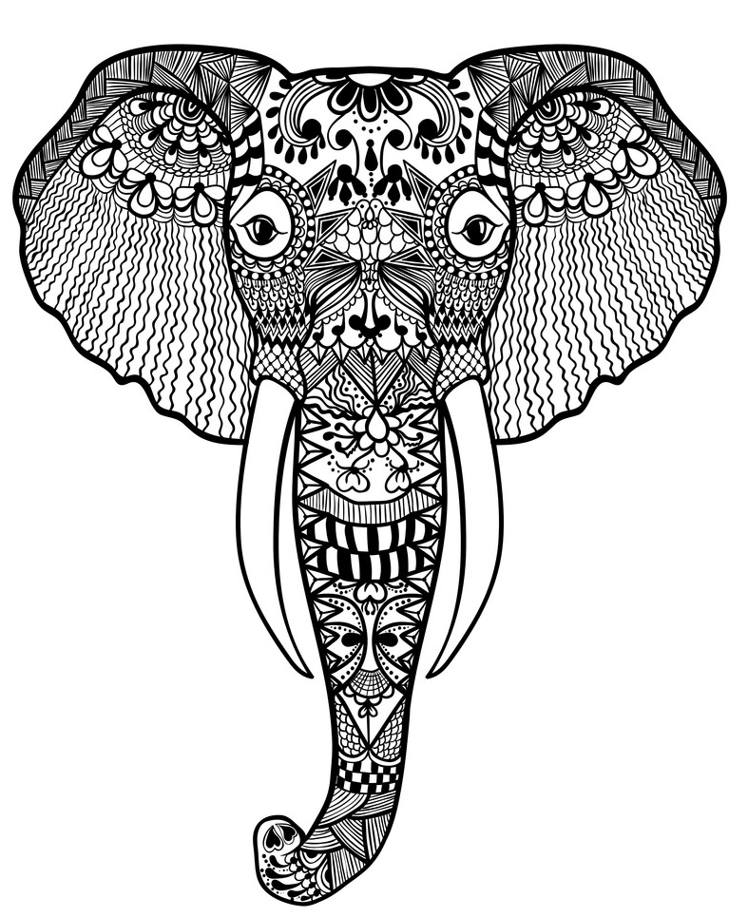
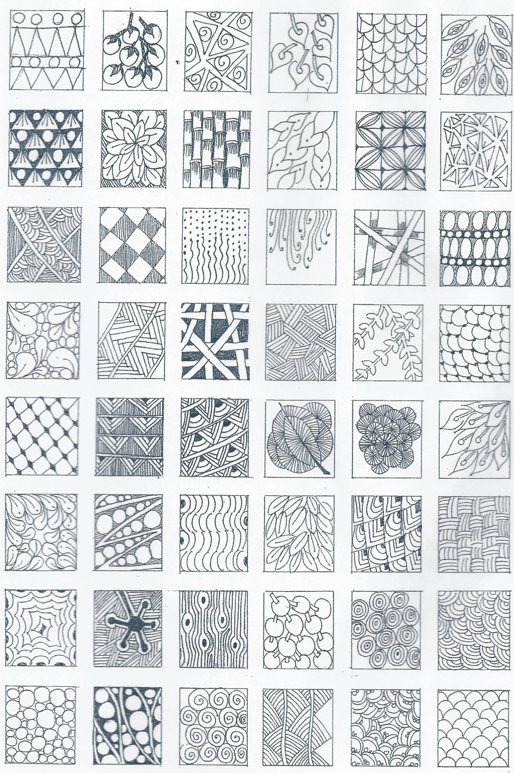
Zentangle Elephant.
On the opposite page, design your own zentangle pattern on the Elephant.
Zentangle is a method of drawing simple repeating patterns.
When making a Zentangle it creates a state of relaxed focus.
It is like yoga or meditation that decreases stress and increases mindfulness, and enhances creativity.

Slide 7
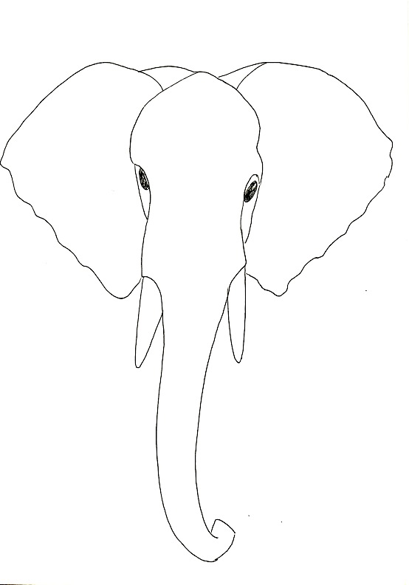

Slide 8
Colour over this African mask in bright colours using coloured pencil – Think carefully about colours and tones.

Slide 9
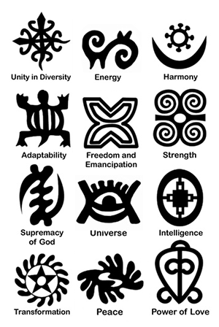
Symbolic Patterns.
Symbolic patterns are used a lot in African art, they all have some sort of meaning behind them.
Design your own African symbol and give it a meaning.

