Slide 1
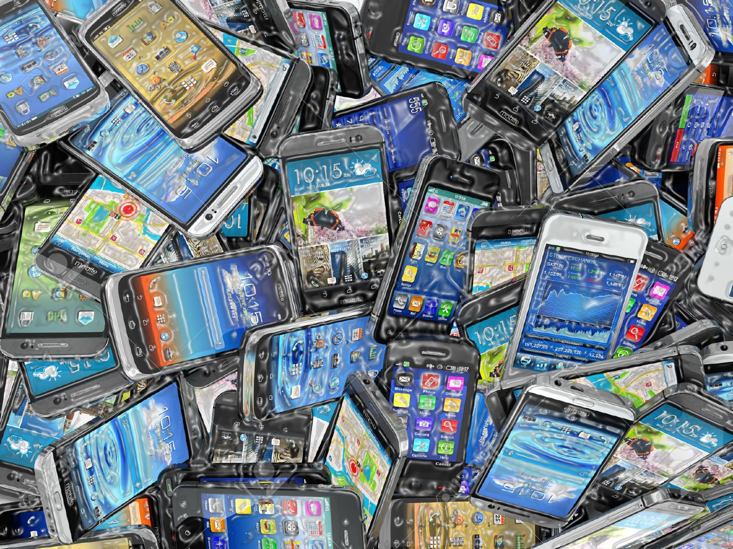
Year 9 Working from home tasks.
At the moment this is what I want you to be doing. Over Easer I will put a longer project together based on Mobile Phone but linked to the written exam that you will be taking next year. Please send me comments/concerns over teams chat and I will help.
The task you need to be working on regularly is learning your lines for Mobile Phone. (anyone without a script let me know if you want me to scan one and put it in files.)
This is a good time to be watching pieces of theatre online as lots of companies release things during the lockdown. Start by watching
https://www.vamostheatre.co.uk/dead-good-full-performance this link will only work until April 5th, it is really good so make sure you watch it. There is also a really good education pack on their website which explains the storyline and gives lots of helpful information.
https://www.vamostheatre.co.uk/learning/resources/education-packs
When you have watched it write a review. There is a write a review help sheet in the files. Make sure you do not write on the original though.

