Slide 1


Introduction for Learners
Do homework and revise online
See also our 6 minute introduction video:

Slide 2
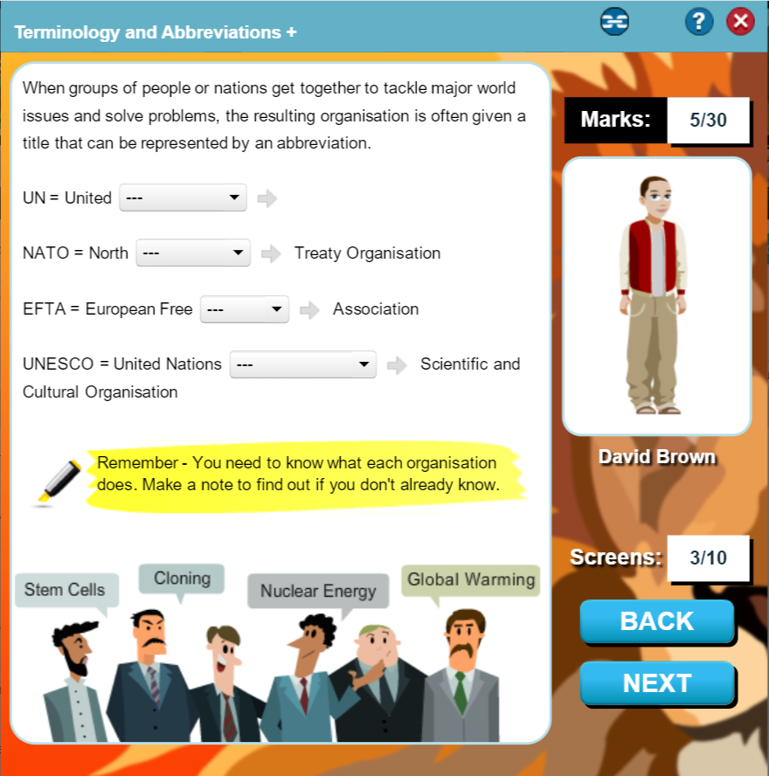
Access over 10,000 Resources and Activities available across all subject areas
(and linked to exam board specific content)
Revise Activities: 10 – 15 minute activities to review knowledge and understanding.
Test Activities: Write your answers and use mark-schemes to self-check answers.
Exam Papers: Timed activities with a mixture of question styles.

Slide 3
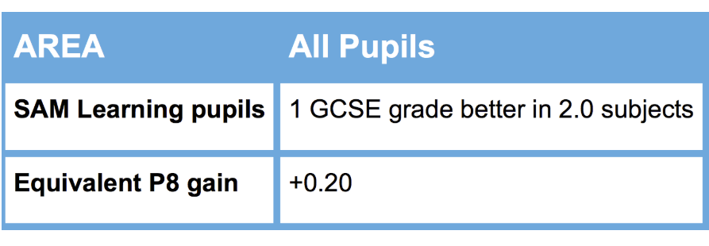
Proven to Improve your Progress!
Research has shown that revising on Sam Learning for more than 10 hours can improve your GCSEs by 2 grades!
SAM Learning
10 Hour
Task Challenge

Slide 4
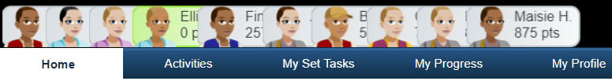
My Set Tasks - for work your teachers have set you to do.
Activities - search for specific topics you want to revise… for the Exam Boards you study with.

Slide 5
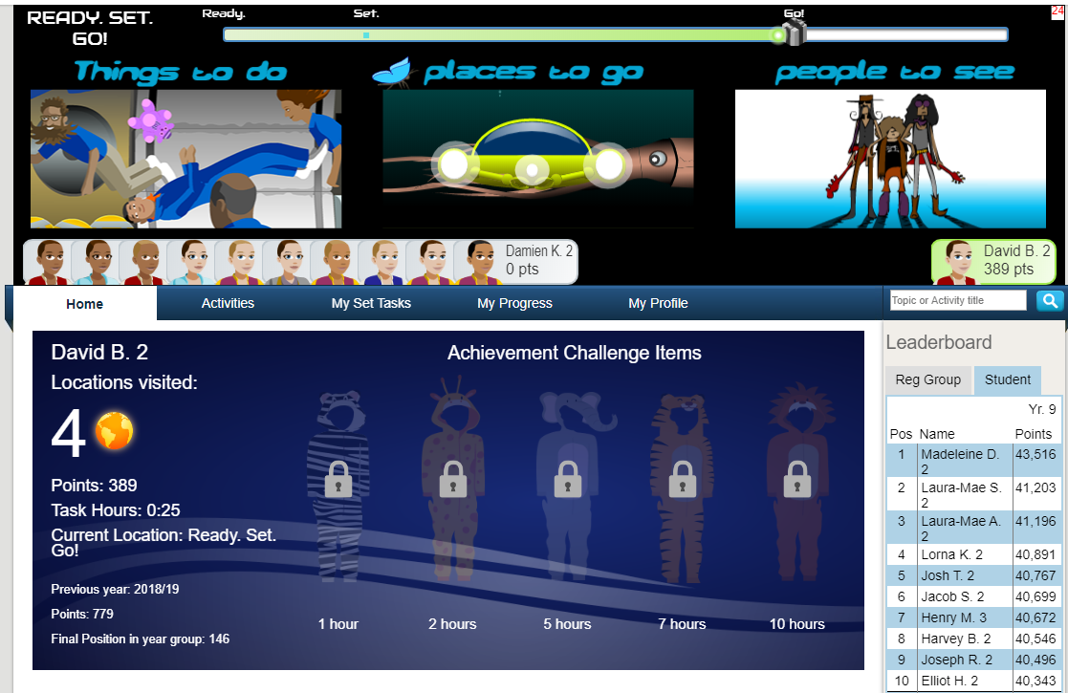
Set up your avatar.
Earn points to Travel SAMWorld and equip your avatar.
Challenge your friends to beat you on tasks.

Slide 6
How to get started:
You can access the SAM Learning service at anytime and anywhere – and it works on any device, from smartphone to home PC. All you need to do is visit the website and enter your unique login details:
Website address: www.samlearning.com
(or use the link from your school website)
Centre ID: | NG3NA
User ID: | Date of birth followed by two initials: first name then last name. Example: 010808DJ is the User ID for David Jones born 1st Aug 2008.
Password: | Initially same as your User ID, you are encouraged to change this to something difficult to guess once you have logged in.

Slide 7

We hope that you are able to make good use of SAM Learning and wish you the best of luck in your studies.

