Slide 1

BTEC Tech Award Creative Media Production

Slide 2
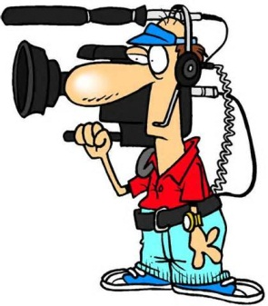

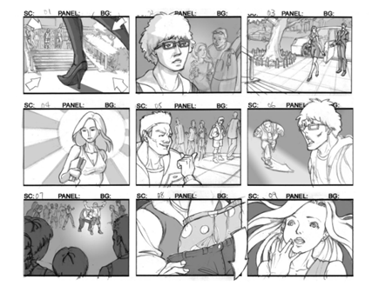
BTEC Creative Media Production
The main difference between GCSE and BTEC:
BTEC is more ‘hands on’ and practical
There is still lots of analysis to complete – it is not just watching and making films!
Your coursework is worth more marks (60%) and your exam will be worth less marks (40%).

Slide 3
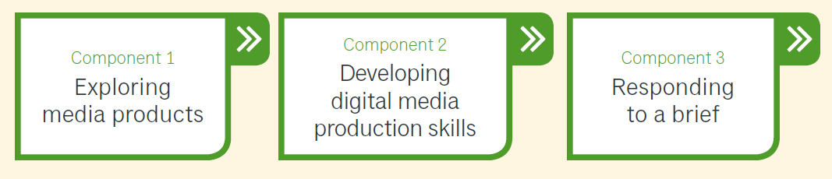
What is the course about?
This course is a practical introduction to what it is like to work on the industry. You will explore the media sector through the following tasks:
Developing technical skills and techniques
Producing a product in response to a brief
Reviewing and reflecting on the process and the outcomes (evaluating your work)

Slide 4

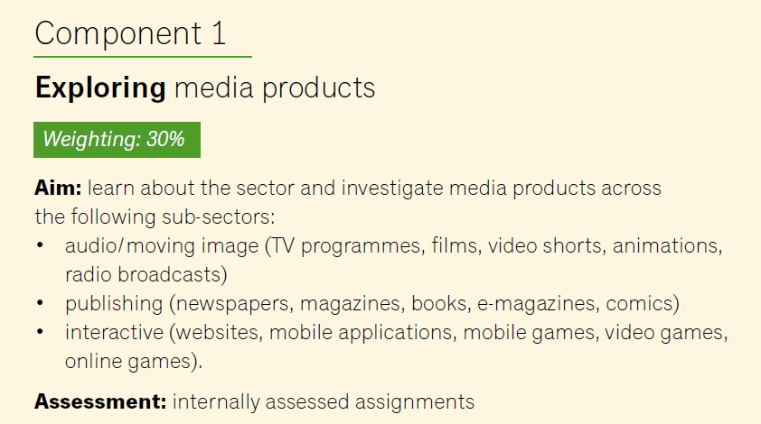

Slide 5
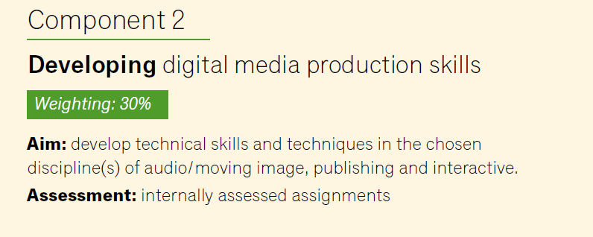


Slide 6
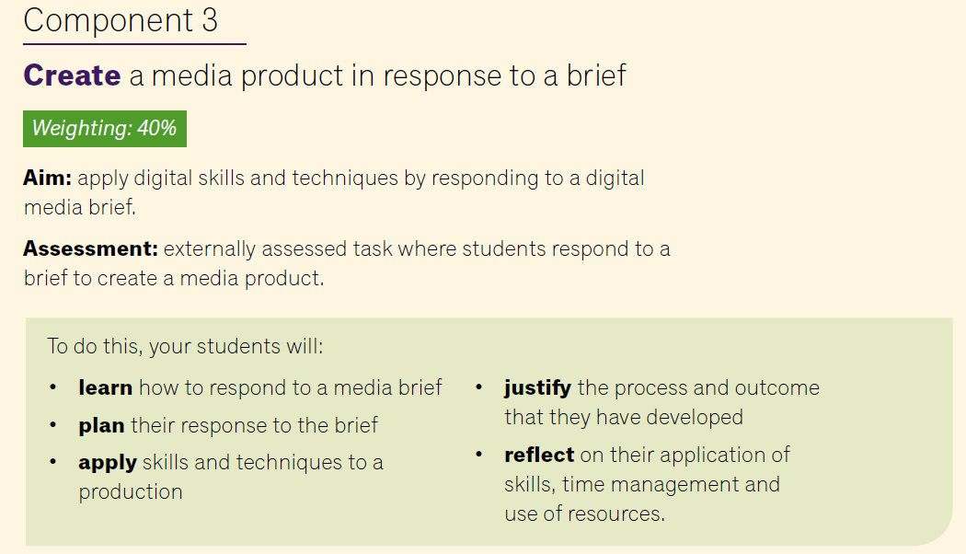
External Assessment - respond to a brief

Slide 7

4 minute video to importance of Creative Industries ☺
https://youtu.be/hO1Eq1pMu6w

Slide 8
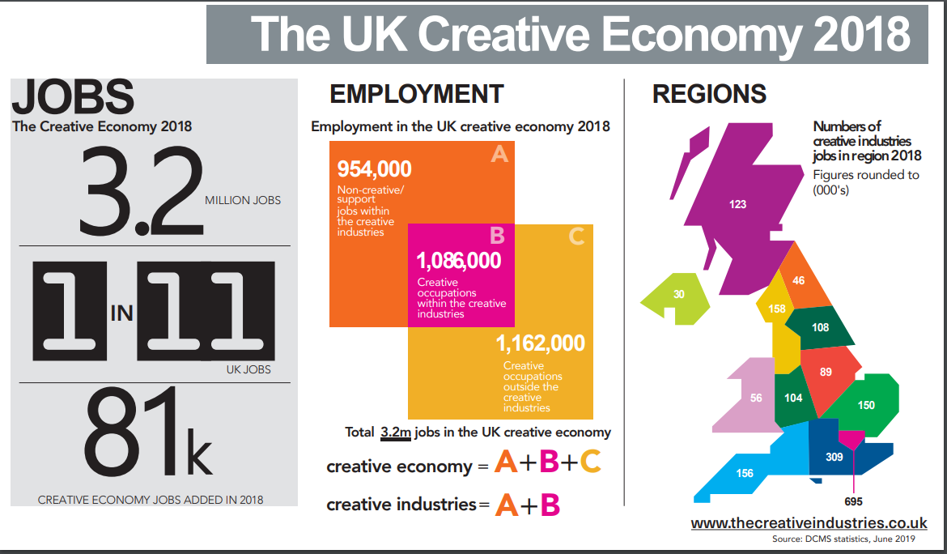
How does the creative industry contribute to the UK economy?

Slide 9
Career prospects?
Jobs directly related to a media degree include:
• Media planner
• Multimedia specialist
• Programme researcher, broadcasting/film/video
• Public relations officer
• Runner, broadcasting/film/video
• Social media manager
• Television/film/video producer
Jobs where your degree would be useful include:
• Advertising account executive
• Broadcast journalist
• Editorial assistant
• Event organiser
• Information officer
• Magazine journalist
• Market researcher
• Designer
• Writer

