Slide 1

GCSE
Psychology
Ms Smikle

Slide 2
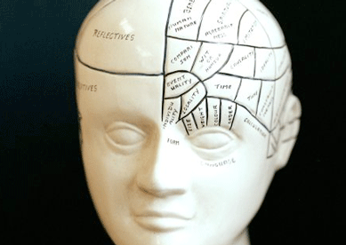
What is psychology?

Slide 3

Psychology
= the science of behaviour and experience

Slide 4
GCSE Psychology
How is it assessed?
100% exam at the end of year 11

Slide 5




Paper 1 = 1 hour 30mins

Slide 6



Paper 2 = 1 hour 30mins

