Slide 1



BTEC DIT
Digital Information Technology
ICT

Slide 2

GCSE
Equivalent
Graded 9-1

Slide 3
COMPONENTS
This qualification has been designed to be a new, exciting and forward-thinking qualification that will prepare students for the modern digital world where they will live and work.
It has three components
Component 1 ( Course Work)
Component 2 ( Course Work)
Component 3 (Exam)

Slide 4

Component 1
In this component you will create a User Interface for a stadium.
You will get hands on experience of the project life-cycle – seeing it through from start to finish
Assessed via coursework
You will learn how to design an interface to interact with a range of users

Slide 5
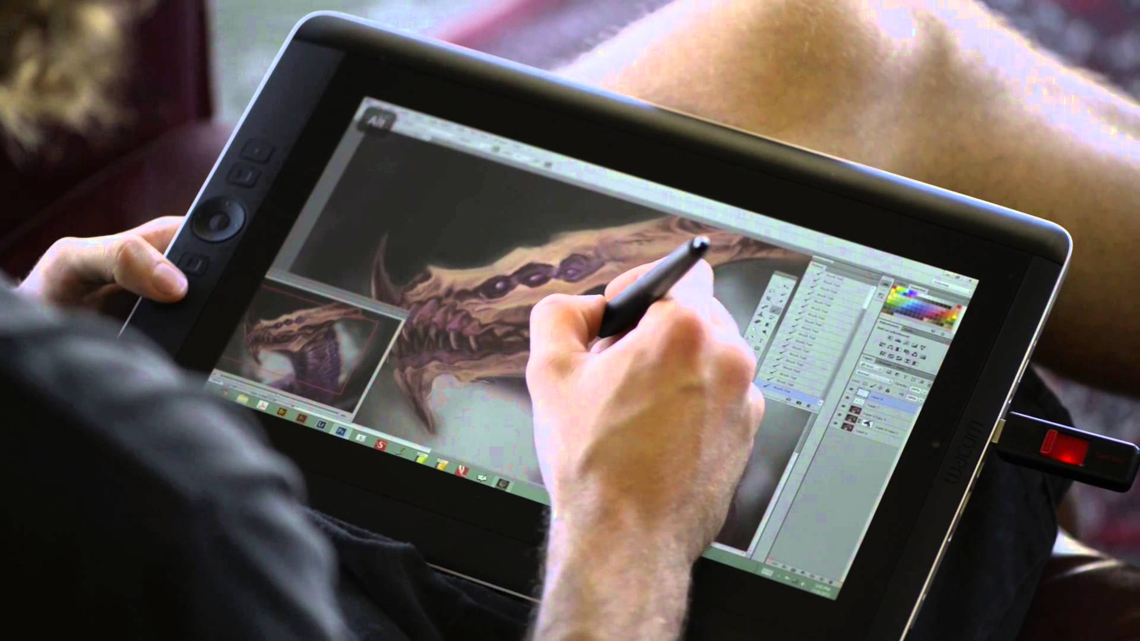
Component 2
In this component you will create a dashboard to present and manipulate data to its user
This will draw on your knowledge from Components 1 and 3
Assessed via coursework
You will learn:
  -How to handle large data files
  -How to ensure the data is presented in a useable format
  -How to present this data to a range of users

Slide 6
Component 3
Impact of modern technologies
How to prevent threats to data
Cloud storage
Cyber Security
Legal framework & Policies
Assessed via exam
Ethical hacking
Different types of malware
Communication technologies

Slide 7
“The focus of the course is on creativity and technical skills”

Slide 8
Students will learn
How to create interactive user interfaces which can be used using a touch screen.
How to organise and manipulate data using a variety of data manipulation tools in Microsoft Excel.
This course requires a lot of independence.

Slide 9

Lots of careers in ICT
Software developer
Ethical Hacking – working for GCHQ
Multimedia designer
Web designer
Graphic artist
Network consultant
Cyber Security
IT Technician / Teacher

