Slide 1
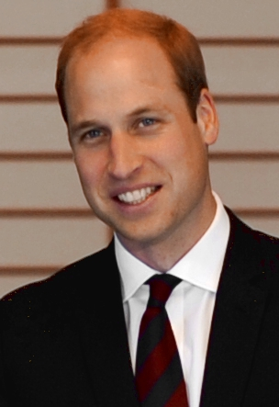


What do these people have in common?

Slide 2
https://www.youtube.com/watch?v=r-fL19dPaeI

Slide 3
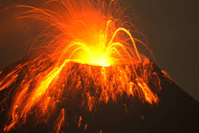
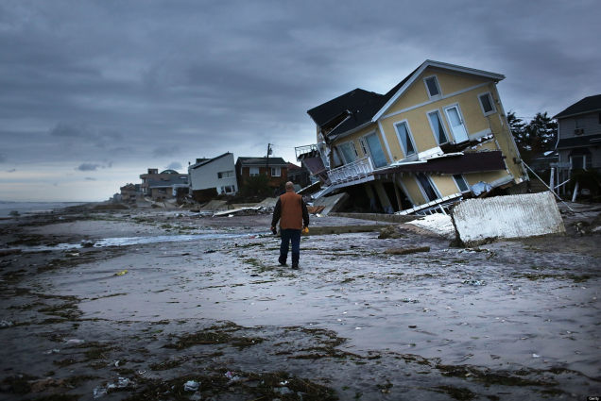

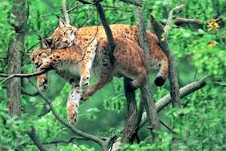
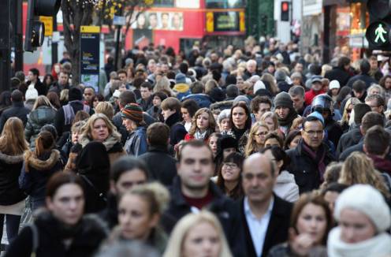
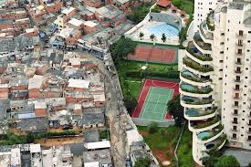


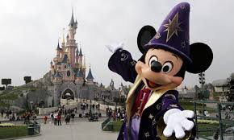
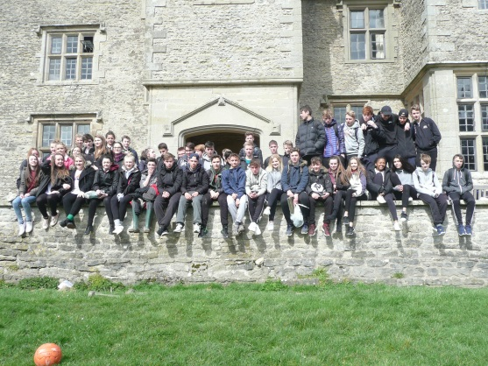
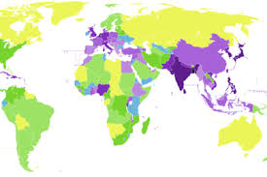
What will we learn about?
Unit 1 – Physical environment
Tectonics, Tropical storms, Rivers, Coasts, Ecosystems
Unit 2 – Human interactions
Population, Development, Globalisation, Resources
Unit 3 – Geographical skills and issues
Maps, field trips, current issues

Slide 4
Going places with Geography
What jobs do geographers do?
Natural environment
Oil and Gas surveyor
Coastal management
Marine biologist
Environmental scientist
Meteorologist
Weather presenter
Government
International development
Flood management
Economics
Town planning
Housing officer
Global issues
HM armed forces
All charity work
Oxfam strategist
International relations
Climate change scientist
Travel, Tourism and Leisure
Conservation Project manager
Travel journalist
Travel agent
Geographical Information Systems
Crime analyst
Google maps/ earth
Cartography (making maps)
Ministry of Defence
Hydrologist
Data analyst
Rightmove and estate agents
Business World
Marketing manager
International sales
CEO
International business strategy
Store locator
Business development manager

Slide 5
Going places with Geography
Why do geographers do so many different jobs?
The Russell Group of top universities names Geography as one of the 8 best subjects for transferable skills because geographers can:
  Present, analyse and evaluate complicated information
  Work in a team
  Research as part of field work
  Understand important global issues, including world trade and business
  Communicate complicated information effectively
  Make decisions based on evidence

Slide 6
Guaranteed at least TWO fieldtrips

Slide 7
https://www.youtube.com/watch?v=5FVgg_u3auA

