Slide 1
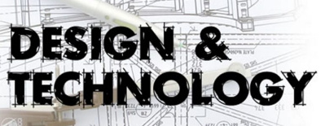
DT Options
at KS4
What do we do?
- WJEC Level 2 Engineering

Slide 2
WJEC Level 2
Engineering
Course Content
Unit 1- Engineering Design
Unit 2- Producing Engineering Products
Unit 3 Solving Engineering Problems
https://www.youtube.com/watch?v=NoyZarq-Zbo
Notes:
What is engineering? Uni of Bath 2:21

Slide 3
WJEC Level 2
Engineering
Unit 1- Engineering Design:
Coursework unit- assessed in school.
Research, design, develop and produce technical drawings
Unit 2- Producing Engineering Products :
Coursework unit- assessed in school.
Manufacture a given design to the highest possible standard

Slide 4
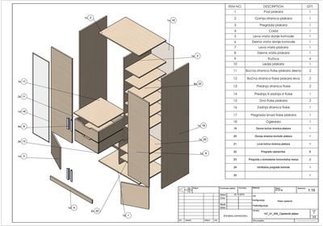
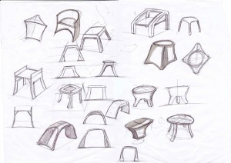
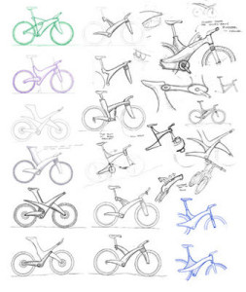
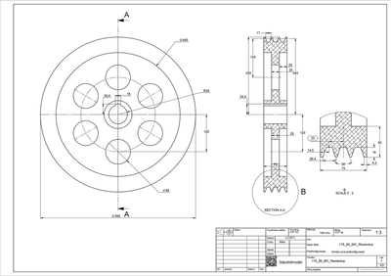
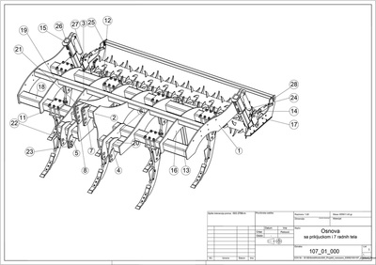
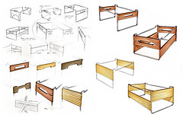
WJEC Level 2
Engineering

Slide 5
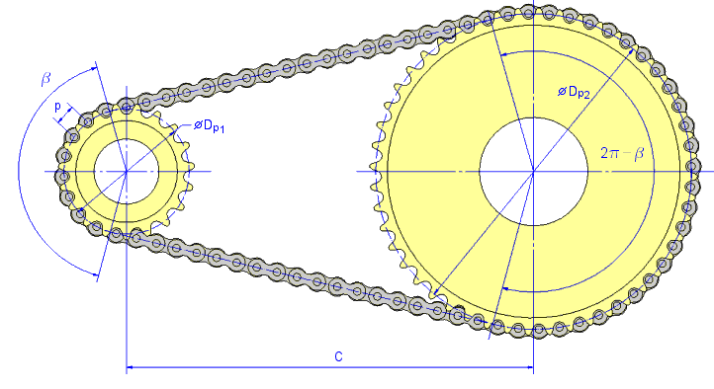
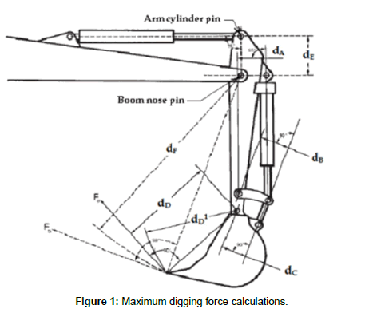
WJEC Level 2
Engineering
Unit 2- Solving Engineering Problems:
Examined unit (2 attempts)
New technologies
Materials and manufacturing
Technical drawing skills
Engineering Maths- measuring, converting and calculating shapes, angles, areas and volumes for parts and assemblies.

