Slide 1
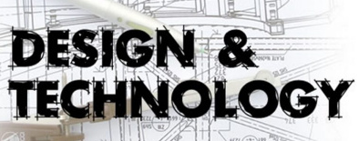
DT Options
at KS4
What do we do?
- WJEC Level 2 Hospitality and Catering

Slide 2
WJEC Level 2
Hospitality and Catering
Course Content
Unit 1- The Hospitality and Catering Industry
Unit 2- Hospitality and Catering in Action
https://www.youtube.com/watch?v=3C92wBOKmDM
Notes:
Top jobs in food 1:18

Slide 3
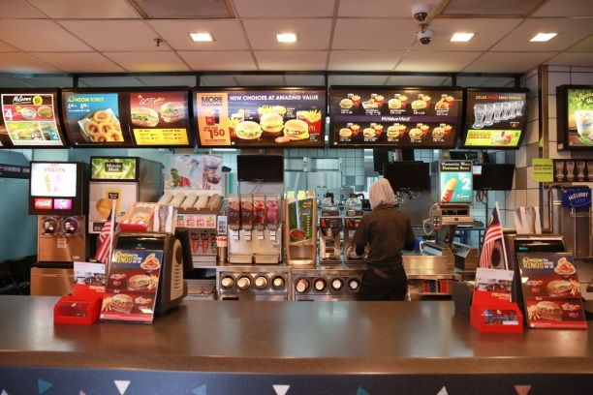
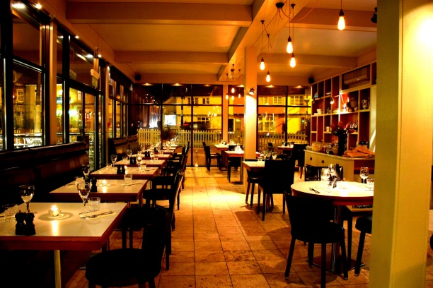

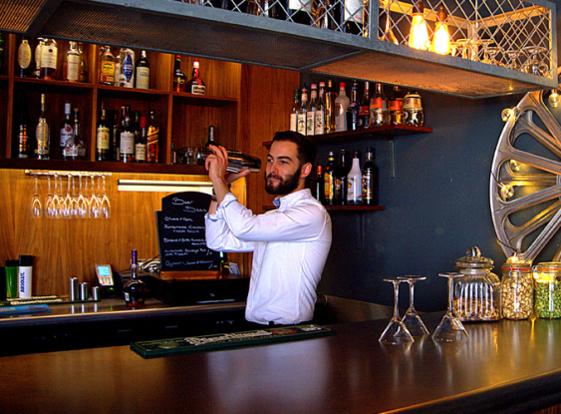

WJEC Level 2
Hospitality and Catering
Unit 1- The Hospitality and Catering Industry
Examined unit (2 attempts)
Learn about the industry as a whole:
Types of business
Jobs, specialisms and operations
Meeting customers needs
Health and safety

Slide 4
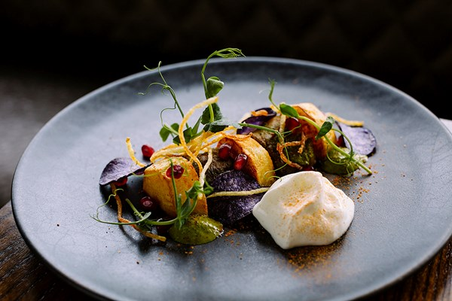

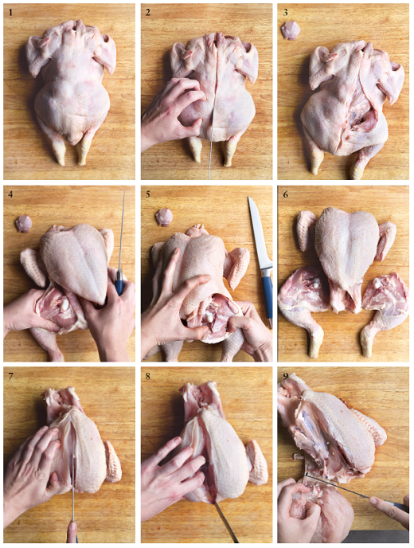

WJEC Level 2
Hospitality and Catering
Unit 2- Hospitality and Catering in Action
Coursework unit- assessed in school
Explore, choose, plan and cook recipes
Cook most weeks- EXPECTED TO PROVIDE OWN INGREDIENTS

