Slide 1
Enterprise year 8
Enterprise

Slide 2

We learn about the business world
A good understanding of business will make you more employable
Our business students have gone on to be successful business people, teachers, accountants, IT professionals, managers, retail experts........

Slide 3
BTEC level 1/2 Tech award in Enterprise
Equivalent to 1 GCSE
Component 1: Exploring Enterprises
Component 2: Planning for and running an Enterprise
Component 3: Promotion and finance for Enterprise

Slide 4




What is the connection?

Slide 5
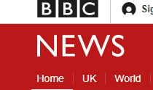
What will you learn?
Why businesses are successful
Market research
Finance
Setting up and pitching your own business idea
Customers
Skills to be an entrepreneur
http://www.bbc.co.uk/news/av/business-11876811/bbc-world-news-business-headlines

Slide 6
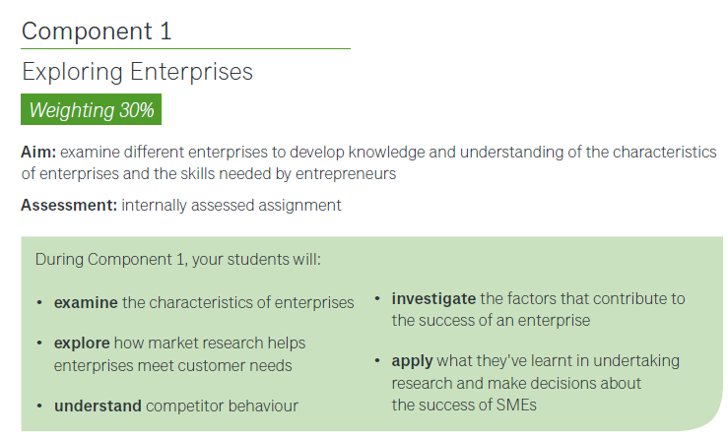
Component 1

Slide 7
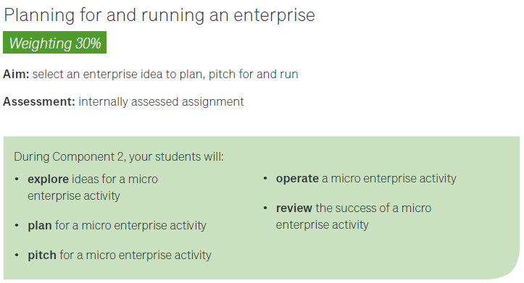
Component 2

Slide 8
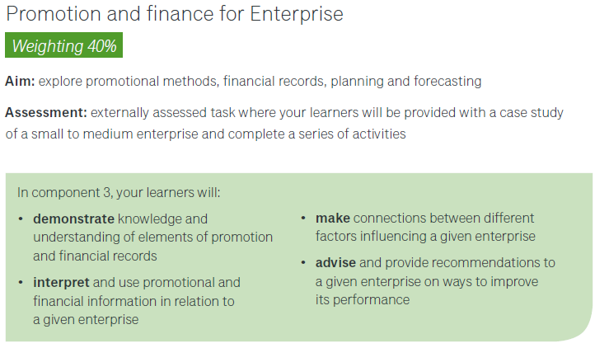
Component 3

Slide 9

If you don’t chose business..

