Slide 1


Health and Social Care
Do you like caring for other people?
Are you interested in how we grow and develop throughout our lives?
Do you want to develop your communication skills?
Are you interested in how to have a healthy lifestyle?
Do careers in health care and social care appeal to you?
If the answers are ‘yes’, then health and social care might be for you!

Slide 2
Health and Social Care
Health and Social Care
Three units of work with mixture of coursework and exam.

Slide 3
Human Lifespan Development (COURSEWORK)
This is about how people grow and develop over the course of their life, from being a baby, right up to old age. You will learn about physical, intellectual, emotional and social development and the different factors that may affect them.
Health and Social Care Services and Values (COURSEWORK)
This unit will give you an understanding of the different health and social care services that you might need to use at some point in your life. It will also help you to develop skills to care for people properly by considering their needs, the services that they can access and your communication when supporting them.
Health and Wellbeing (EXAM)
This unit looks at factors that can have a positive or negative influence on a person’s health and wellbeing. You will learn assess people’s health and to use information to design a plan for improving someone’s health and wellbeing.

Slide 4
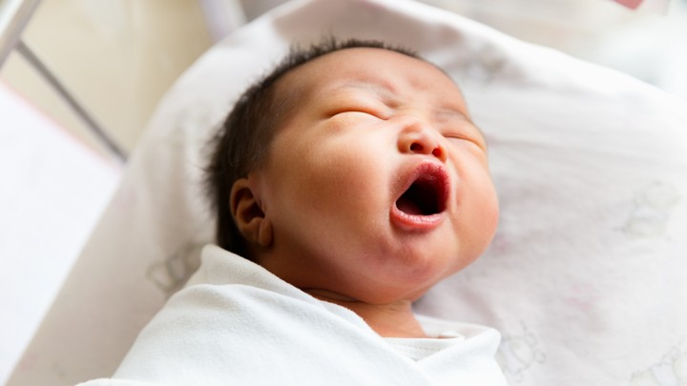
Child Development
Do you enjoy being with babies and young children?
Have you ever wondered why toddlers behave like they do?
Would you like the opportunity to read stories, play games and take part in children’s activities?
If the answers are ‘yes’, then child development might be for you!

Slide 5
Child Development
The course is split into three units of work with mixture of coursework and exam.

Slide 6
Children’s Growth and Development (COURSEWORK)
This unit will develop your knowledge and understanding of children’s growth and development across five areas of development – physical, intellectual, communication and language, social, and emotional. You will look out for developmental expectations and examine factors that might affect a child’s growth and development.
Learning Through Play (COURSEWORK)
Here you will explore the different stages of play that children experience, and learn about how play can be structured by adults to encourage and influence learning and take part in developing your own play activities.
Supporting Children to Play, Learn and Develop (EXAM)
This unit will develop your knowledge and understanding of the individual circumstances that can have an impact on a child’s learning and development. You will also investigate the role of the adult in making sure that all children are safe when engaging in play activities. and how activities can be adapted to ensure that all children can join in with play for their learning and development.

