Slide 1
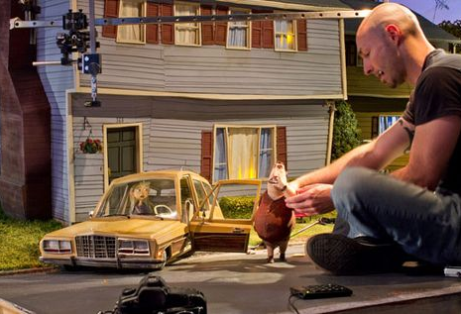
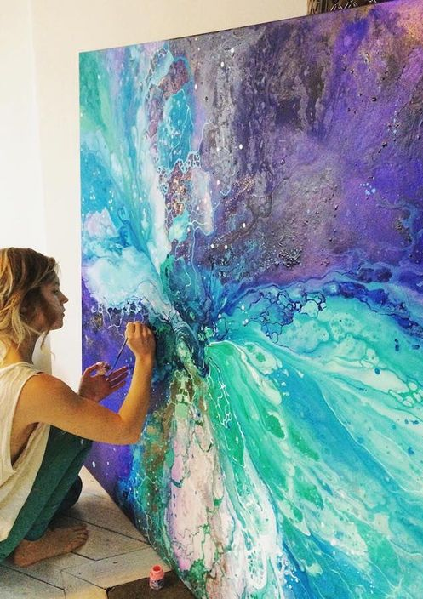
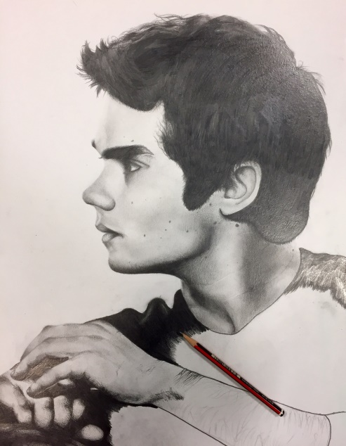

A Level Art and Design FINE ART
Art & Design is suitable for a wide variety of students. Including gifted artists who wish to pursue a career in creative industries, those wishing to balance academic and practical subjects and those who simply enjoy Art & Design and are willing to work hard.
Component 1: Portfolio of work. Personal investigation project set by student - 60% of total mark.
Component 2: Externally set brief – project set by AQA - 40% of total mark.
15 hours of sustained focused study (exam).
This is a broad-based course exploring practical, critical and contextual work through a range of 2D and/or 3D processes and media.
A Level Art and Design (Fine Art) gives you the skills and knowledge to create personal and imaginative work. You can choose to focus on a specialist area of study from a variety of exciting processes and media to suit your individual interests and abilities. This can result in Art Foundation, degree opportunities and careers ranging from painting portraits to producing exotic fashion costumes or designing futuristic architecture. If you have an adventurous, creative and enquiring mind and are excited by shaping and determining the visual world around us, there is a career opportunity waiting for you.
Drawing produced by year 10 student.
Further study and career opportunities:
Art & Design A Level provides the perfect spring board for students to progress to A-Level and University.
Future Prospects/Career Options:
The creative industries in the U.K are rapidly growing. They contribute £111 billion to the economy and employ over 3 million people. People with creative skills are highly valued in a rapidly changing world of work. There are hundreds of special-isms but it is competitive and you need to work hard.
Animator
Architect
Art Therapist
Blacksmith
Ceramics
Cartoon/Comic art
Community arts
Costume design
Exhibition design
Fashion design
Film director
Fine artist
Furniture design
Game design
Graphic design
Illustrator
Interior design
Jewellery design
Make up/Hair design
Medical illustrator
Photographer
Product design
Sculptor
Set designer
Tattoo artist
Teacher
Theatre design
Web design

Slide 2
Year 12:
Experimentation & Skills building which leads into Component 1
Year 13 :
Component 1: Theme based work which is worth 60 % of A Level
Deadline for component 1 is end of January 2023
Component 2:
February 2023
Externally Set Assignment from AQA

Slide 3
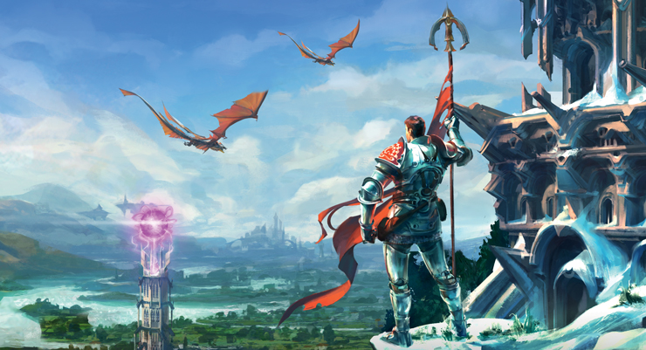
The Creative industry is the fastest growing sector!
There are currently over 3 million creative jobs in the UK.

Slide 4
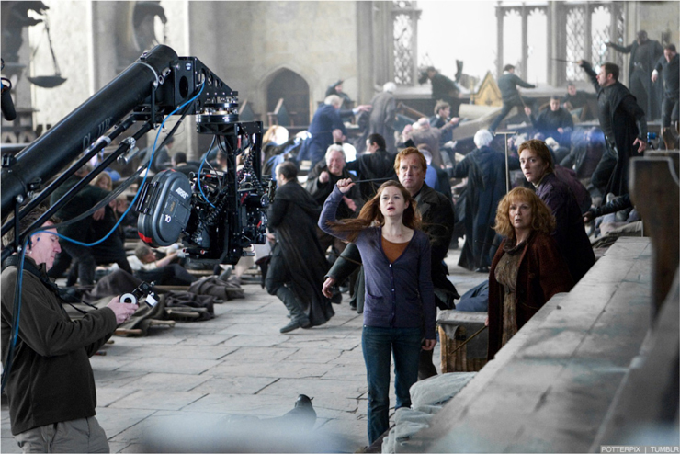
Creative industries is worth £111 billion pounds a year.

Slide 5
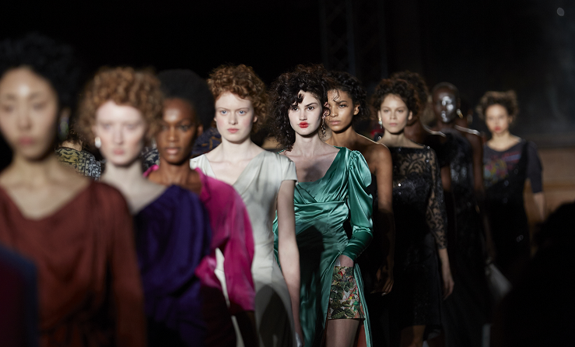
UK creative industries employment is growing at four times the rate of the UK workforce as whole.

