Slide 1
Welcome to
GCSE Religious Studies
Islam, Philosophy & Ethics
You tube
https://www.youtube.com/watch?v=G5VWf84r33U
ThePianoGuys Live at Red Butte Garden - Beethoven's 5 Secrets (Cello/Orchestral Cover)

Slide 2
Why take this course?

Slide 3
Religion is everywhere
84% theist
16% atheist
Engage in a subject where different cultures and beliefs are explored
33% Christian 2.4 billion people
24.1% are Muslim, 1.8 billion people
Learning about religion is about understanding people, life and the world.

Slide 4



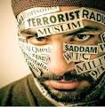
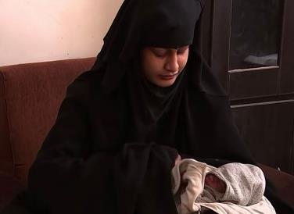
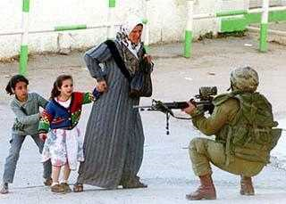
Islam is always in the news…
Muslim Ban

Slide 5
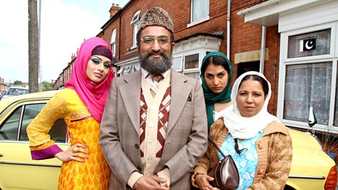
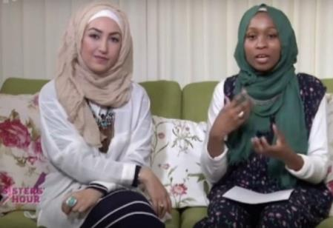
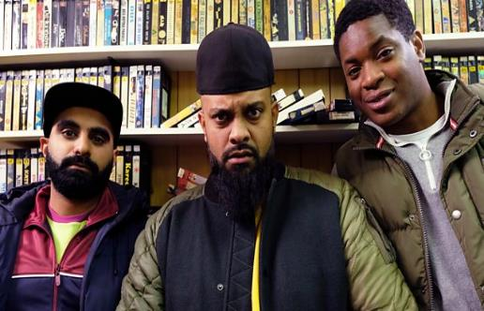
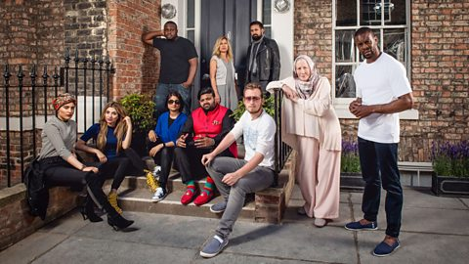
Muslims on TV…
These are some of the programmes we will watch to analyse issues affecting Muslims

Slide 6



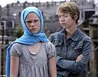




In Films…
These are some of the films we will watch to analyse issues affecting Muslims

Slide 7
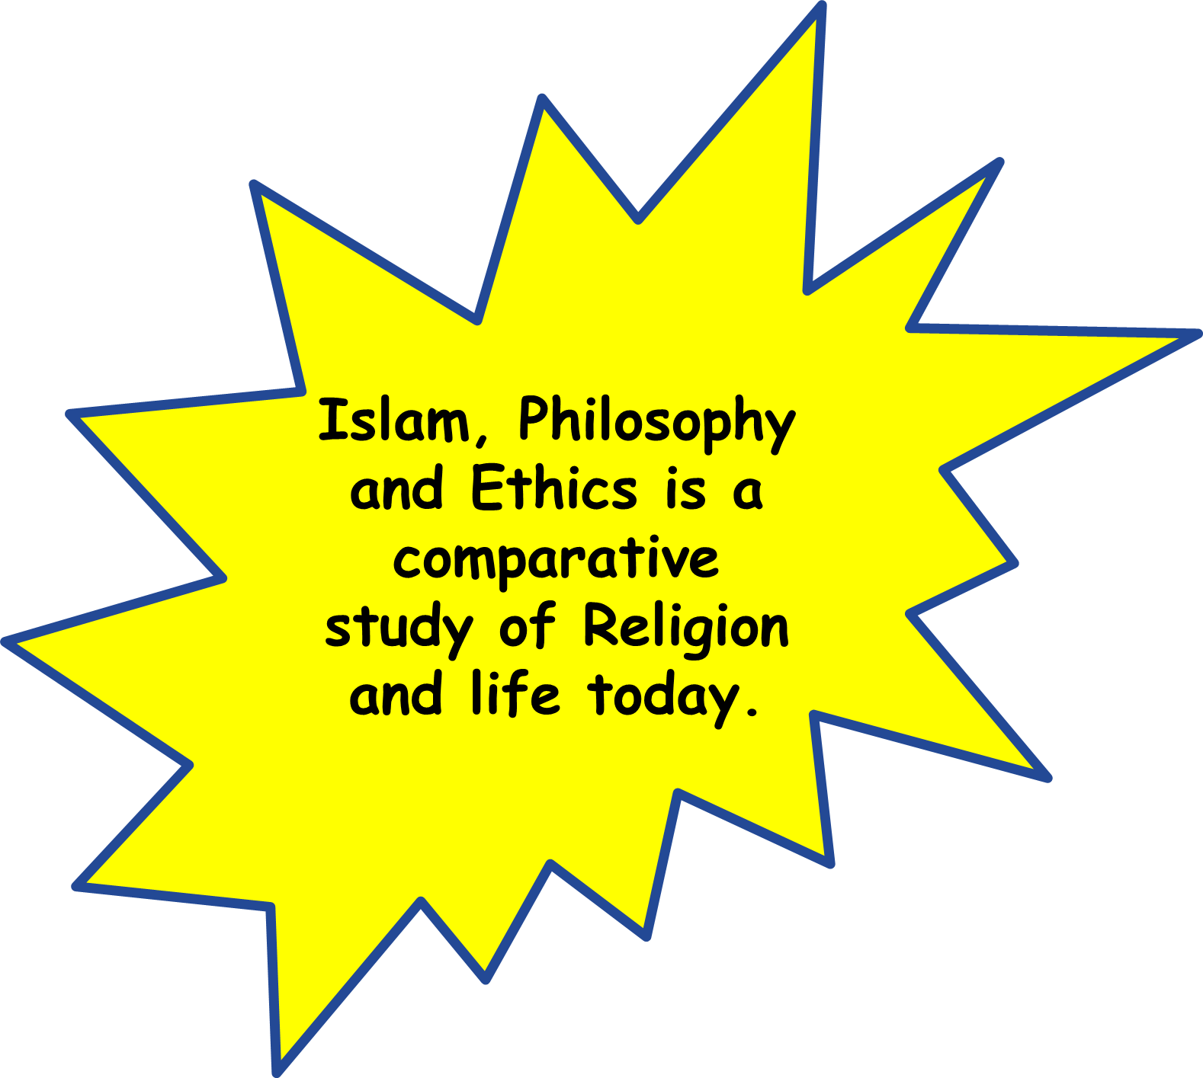

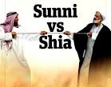
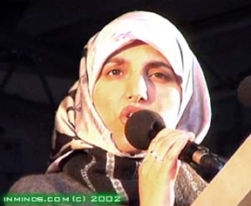

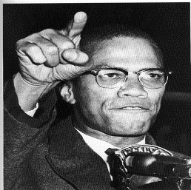

Muslims are just Arabs or Pakistanis, but from all parts of the world

Slide 8
The course will cover 3 areas:
1) Islam
2) Christianity
3)Philosophy & Ethics

Slide 9
Area 1: Islam 50%
This covers:
Beliefs and teachings,
Practices,
Sources of Wisdom & Authority,
Forms of Expression,
Ways of Life.

Slide 10
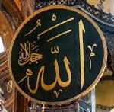
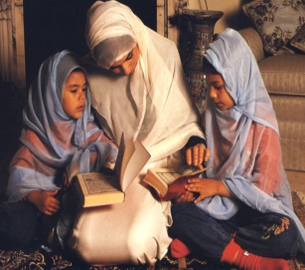




Islamic beliefs and Practices.
Family life
Charity
Why are these beliefs and practices important for Muslims?
Hajj

Slide 11
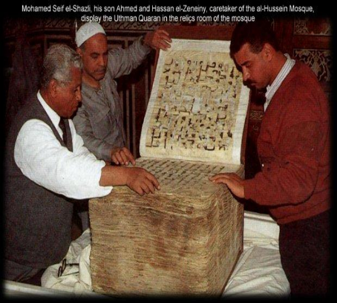





Sources of Wisdom & Authority
Where do Muslims get their guidance?
Hadith
The Holy Qur’an in it’s original form
Shari’a Law, what’s it all about?

Slide 12
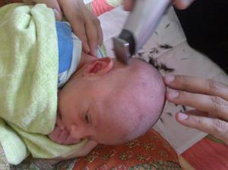
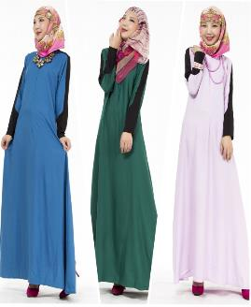
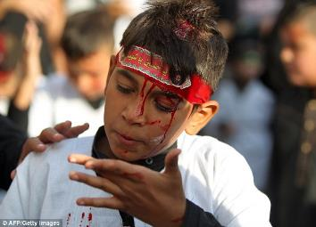
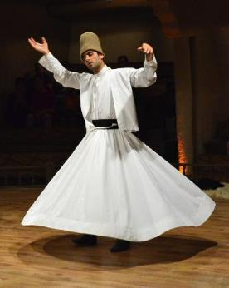
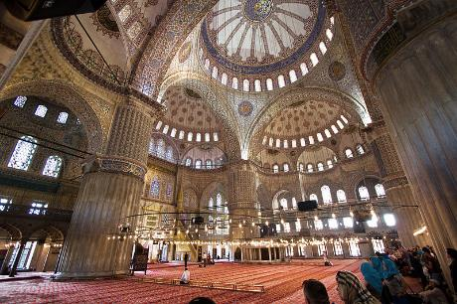
Forms of expression
Aqiqah/birth ceremony
Islamic Dress
Shia commemorating Ashura
Features of a Mosque
Whirling Dervish – Islamic Sufism

Slide 13
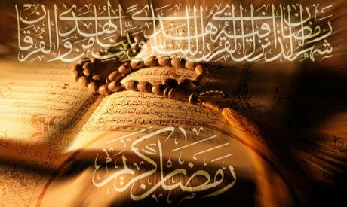


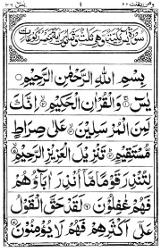
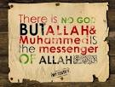
Compilation of the Qur’an
The oldest Qur’an in the world
Muslims believe in 124,000 Prophets
Calligraphy of the Qur’ an
The life of Prophet Muhammad (pbuh)

Slide 14
Area 2: Christianity 25%
This covers:
Beliefs and teachings,
Practices,

Slide 15

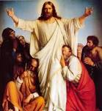





Christian beliefs
Christians believe Jesus is God
Christians believe in original sin
Salvation lies at the heart of Christianity?

Slide 16
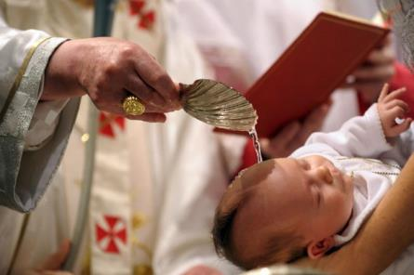




Why is prayer important?
Christian practices
What is a baptism?
What are the similarities and differences between Muslim and Christian practices?

Slide 17
You will analyse the similarities and differences between Christians and
Muslims

Slide 18
Area 3: Philosophy & Ethics 25%
This covers:
Arguments for and against the existence of God, marriage, divorce, homosexuality, equality, racism from an Islamic view point

Slide 19
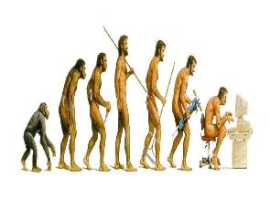
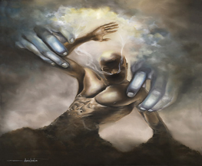
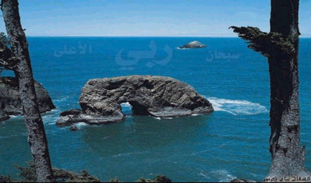
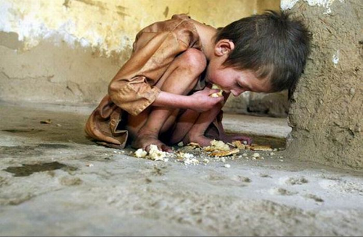

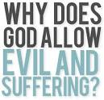
Philosophy
Is this rock praying?
Science V Creation
Does everything have a cause?

Slide 20
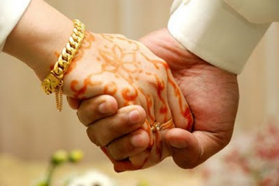
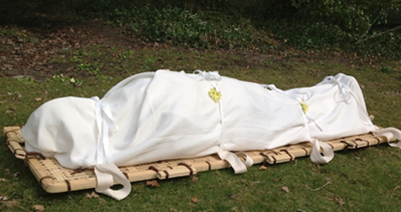
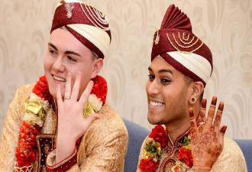

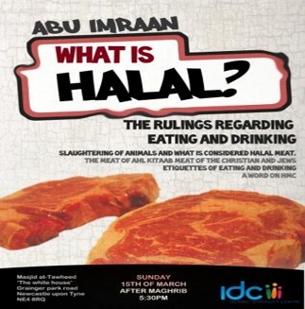
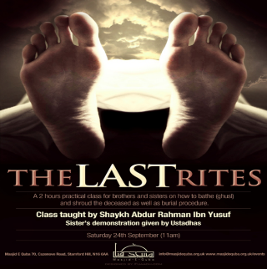
Islamic Ethics
Marriage & Divorce
Janaza/death
Homosexuality
Nikkah
Halal & Haram
Why don’t Muslims drink alcohol or eat pork?

Slide 21
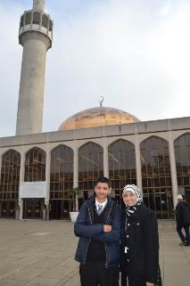
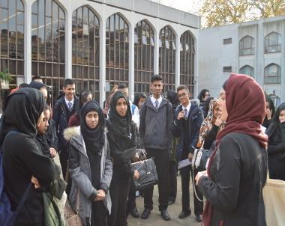
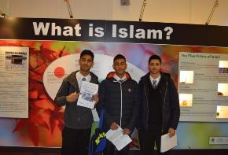
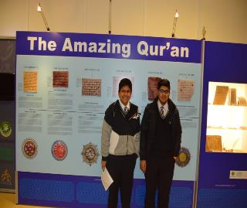
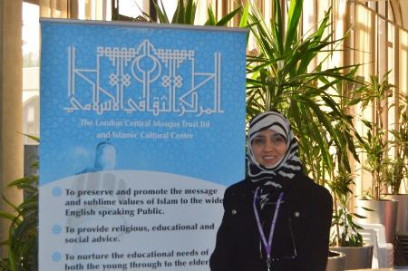
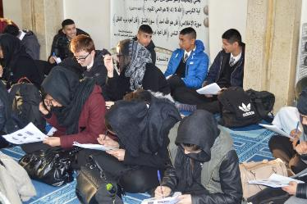

We go on trips to London Islamic Cultural Centre

Slide 22
How will I be assessed?
In yr11 you will have 3 examinations
1: Islam 1hr 45 mins (50%)
2: Christianity 50 mins (25%)
3: Phil&Ethics 50 mins (25%)

Slide 23
What skills do I need?
You don’t have to religious or be a Muslim. Just be Interested:
Join
in discussions
Prepare to work hard
Be Organised
Ask controversial questions
Be respectful

Slide 24
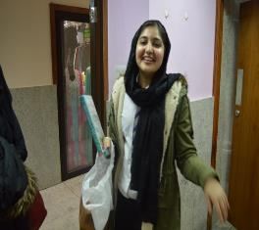
student's views
Highly recommended!!!
Helped me get into sixth form
Even though I am Muslim, this course taught me a lot about other religions
Thoroughly enjoyable!!
It opened my eyes because I learnt about myself
Brilliant!!
Learnt useful life skills such as preparing the dead for burial

Slide 25



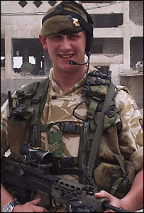


What jobs can RE lead to?
* Armed Forces *
* Teaching *
* Banking *
* Retailers *
* Social Work *
* Journalism *
* Engineering *
* Acting *
* ICT *
…to list just a few!

Slide 26

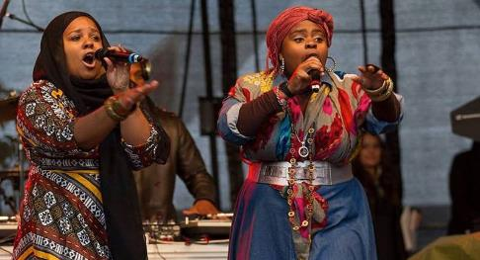
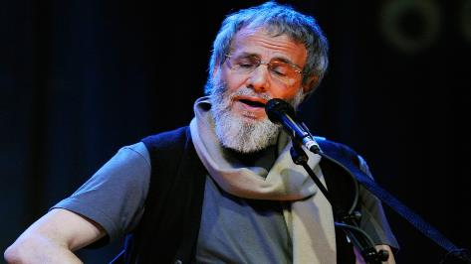
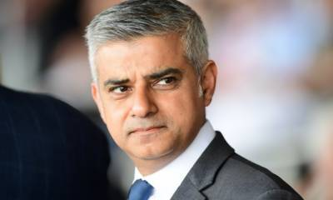
Taking RE shows Universities and employers that you understand The World, Life and People
Every Job needs this
Engineering
Muslim rap artists
Music
Politics

Slide 27
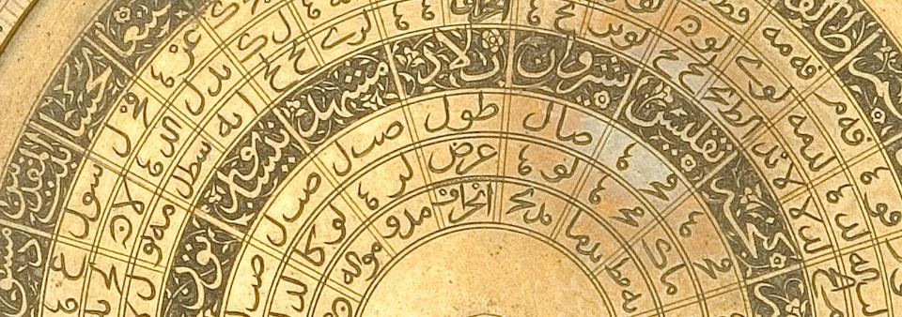

“RE incorporates such a broad range of skills that are transferable to many different situations, from literary-critical to historical-critical to evaluative skills.
The subject gives you great potential for academic and personal development, it’s what employers look for. ”

Slide 28
What do I do next?
Talk to Ms T Khan, Mr Hammerton or Ms Parr
in DH4
Tick RE/Islam in the option block

