Slide 1
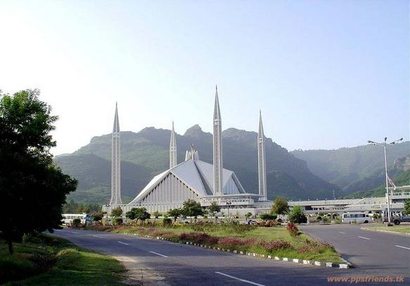



GCSE URDU
Excellent grades at GCSE
4th most spoken language in the world (UN)
Learn culture, religion, history & geography of Pakistan.
HOW WILL YOU BE TESTED!
Unit 1: Listening 25%
Unit 2: Reading 25%
Unit 3: Speaking 25%
Unit 4: Writing 25%

