Slide 1
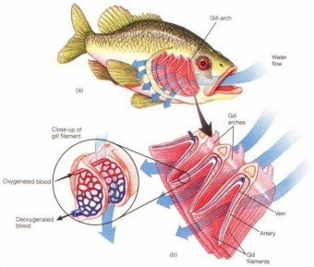
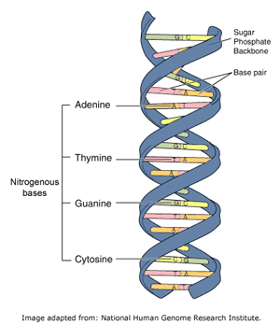
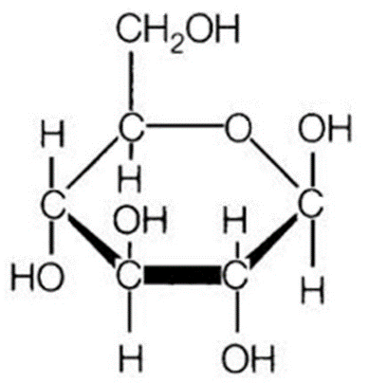
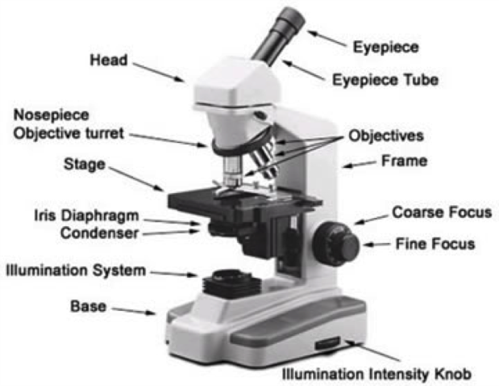
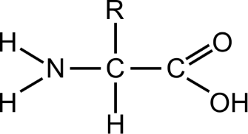
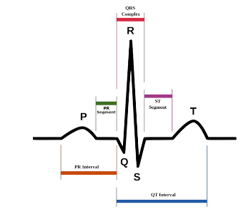
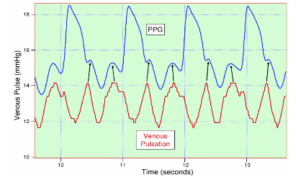
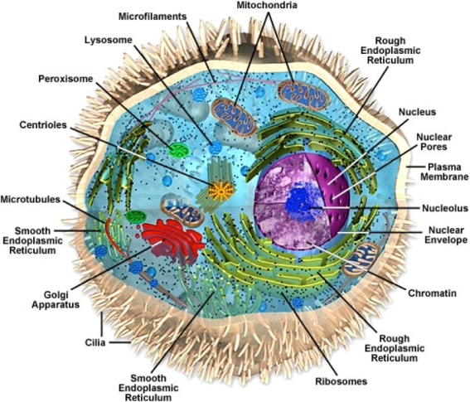
A Level
Biology
Entry requirements :
Science – grade 6
Maths – grade 6
English – grade 6
Taught by Mrs Hardcastle and Mr Robinson

Slide 2
How can the heart be strong enough to pump blood up your legs against gravity?
Why does every cell in our body contain DNA?
Will we ever cure cancer?
How do nerves control every organ and function in the body?
How do we beat bacteria?
Have you ever wondered?
How do trees give earth all its oxygen?
How does a fish breath underwater?
If yes, A-level Biology is the subject for you!
All of these questions are discussed or linked to different areas of our curriculum.
How long before genetic sequencing is able to tell us exactly how our children will look and act?

Slide 3
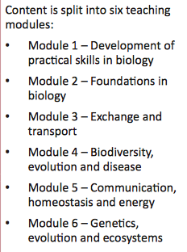
The course
OCR Biology is split into 6 modules
Module 1 is covered throughout the course whenever we carry out a practical
Modules 2, 3 and 4 are covered during year 12
Module 5 and 6 are covered during year 13

Slide 4
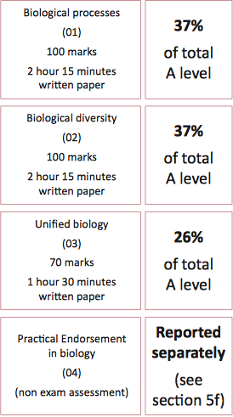
Assessment
All exams take place at the end of the 2 year course
Practicals that are done in the lesson over the 2 years

Slide 5
Practicals that you will carry out over the course
Microscopy
Dissection
Sampling Techniques
Rates of Enzyme Controlled Reactions
Colorimeter or Potometer
Chromatography or Electrophoresis
Microbiological Techniques
Transport in and out of cells
Qualitative Testing
Investigation Using a Data Logger
Investigating Plant/Animal Responses
Research Skills

