Slide 1
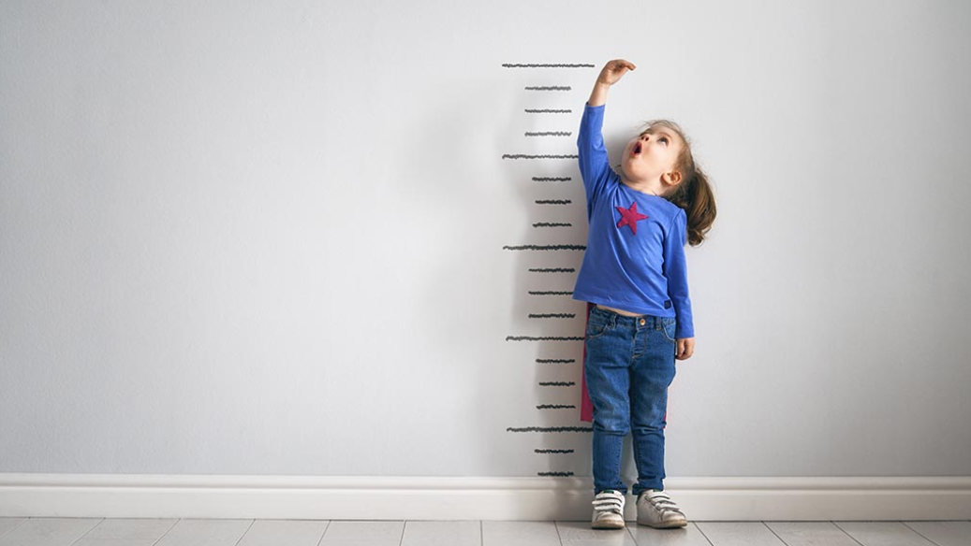


Look how big I am everyone
BTEC Level 3
Extended Certificate
Children’s Play, Learning
and Development
Mrs Brown

Slide 2


Children’s Play, Learning & Development
The course explores…
how children grow and develop from birth to 8 years old.
what milestones are and when children meet them
contributions of key theorists and how they help us to understand the cognitive, physical, social and emotional development of children
The importance of and types of play
Care routines
Career Pathways:
Paediatric Nursing
Degree in Childhood Studies
Primary School Teacher
Family support worker
Teaching Assistant
Nursery Nurse
Play Therapist
Social Worker

Slide 3

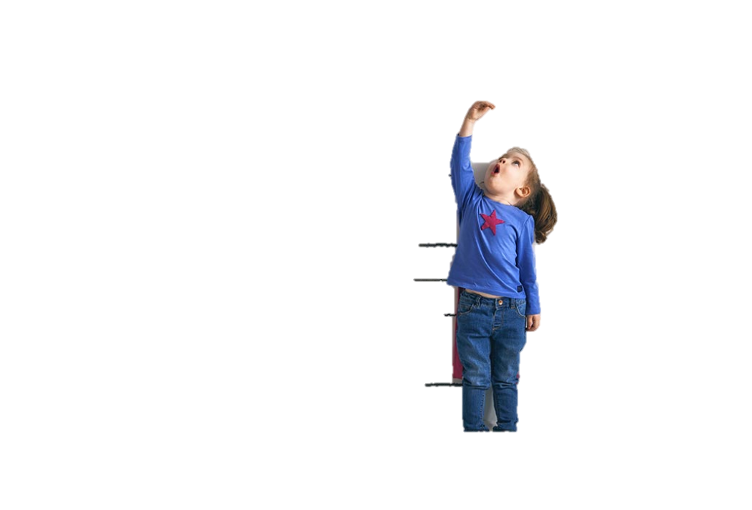
…this is how we structure the two years
Year 2
Year 1
Unit 2: Development of Children’s Communication, Literacy and Numeracy Skills
Examined Unit
Unit 6: Children’s Physical Development, Care and Health Needs
Coursework Unit
Unit 1: Children’s Development
Examined Unit
Unit 3: Play and Learning
Coursework Unit

Slide 4







1.
2.
3.
Development Matters in the Early Years Foundation Stage
Any Mother and Baby magazine
www.literacytrust.org.uk – focus on Early Years
Help your baby learn to talk – NHS https://www.nhs.uk/conditions/pregnancy-and-baby/helping-your-childs-speech/
Take part in an interactive session. E.g.
Rainbow Stripes on Zoom
Mr Tumble https://www.bbc.co.uk/programmes/b008hvwx
If you have younger siblings under 8 do some observations while they play.

Slide 5

If you have any questions or would like more information about the course, please email me tbrown@nottinghamacademy.org

