Slide 1

Year 9 Options
Nottingham Academy
Everyday
Exceptional

Slide 2



Year 9 Options
2024
At the beginning of February students were introduced to the options process and began to hear more about the subjects on offer to them moving into Year 10
In assemblies and tutor time, the Head of Year and tutors have been running through presentations that detail key facts about the courses on offer.
Students have also had the opportunity to use the software Unifrog to start them thinking about careers to help guide them with their courses.
Hopefully your child has been taking the time to discuss their possible choices with their teachers and you, their parents

Slide 3
Year 9 Options
2024
Options are an important part of moving onto GCSE courses
It is important to take some time with your child to consider what they might like to study when they leave school and which options may help them to get to their chosen destination
It’s important that your child does not to select an option just because their friend has selected the subject. Many subjects will have multiple groups so you may not be in the same lesson.

Slide 4
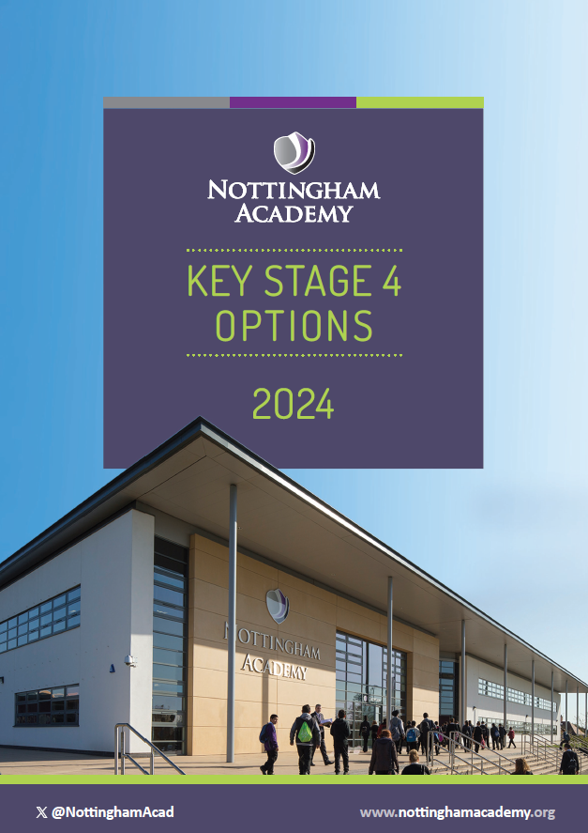
Year 9 Options
2024
Your child will be given an options booklet in their tutor time tomorrow (Tuesday 27th February).
Please ask to see this booklet and go through it with them.
In it are details about the options blocks and the different courses that are on offer.
Your child will need to choose 3 subjects from 3 separate option blocks.

Slide 5
Year 9 Options
Timeline
Week commencing 5th February
Discussions begin within lessons of options subjects
Curriculum leaders and subject leaders' drop-in sessions during Year 9 tutor time and presentations available during Tutor
Week commencing 26th February
Options process launched to parents on Progress Evenings
Letter to parents detailing process
Students and parents provided with the official options booklet
Support available via HoY and SLT
Week commencing 11th March
MS Form made available to all students to complete final choices
1-2-1 meetings will follow before confirmation of courses

Slide 6
Year 9 Option
Core
All students will complete the following courses:
English Language
English Literature
Mathematics
Statistics
Combined Science (worth two GCSEs)
Core PE (not examined)

Slide 7
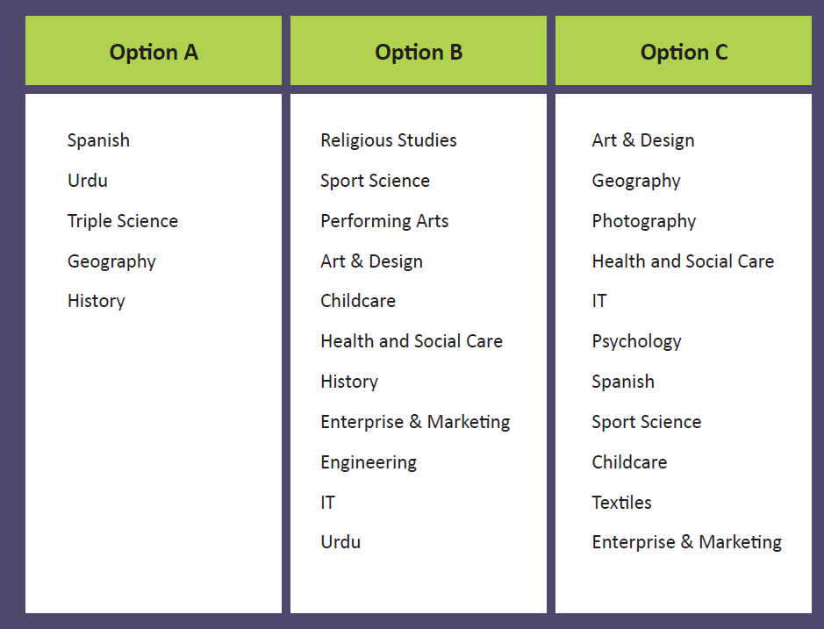
Year 9 Option Blocks

Slide 8
Year 9 Option
Block A
Students must select one of the below subjects:
Spanish
Urdu
Triple Science
Geography
History

Slide 9
Year 9 Option
Block B
Students must select one of the below subjects:
Religious Studies
Sport Science
Performing Arts
Art and design
Childcare
Health and Social Care
History
Enterprise and Marketing
Engineering
IT
Urdu

Slide 10
Year 9 Option
Block C
Students must select one of the below subjects:
Art & Design
Geography
Photography
Health and Social Care
IT
Psychology
Spanish
Sport Science
Childcare
Textiles
Enterprise & Marketing

Slide 11
Year 9 Options Choices
– Advice to students
Do
• Select courses you are interested in
• Select a range of different courses so you have a broad base for Post 16 study
• Read the options booklet
• Discuss with parents/carers/ teachers/tutors/ HoY
• Think very carefully about the subjects you select. It is very difficult to change once the course have started
Don’t
• Select a course simply because your friends have
• Do not drop a subject you may wish to study following Year 11
• Do not drop any subject you may require for a future career or course

