Slide 1


A Level Criminology

Slide 2


What is Criminology?
Criminology involves analysing illegal human behaviours and crime prevention methods.
The field of criminology blends social science and psychology with criminal justice.
As a criminologist, you'll explore the many causes of criminal activity among different groups of people.

Slide 3
Some of the areas you will study on this course
Different crimes
Forms of punishment
Prison
Evidence collection
The English legal system
Criminal justice workers
Criminal case studies
Laws
Theories on why people commit crime
Victims
Sociology
Psychology
The media
Campaigns
Research methods

Slide 4
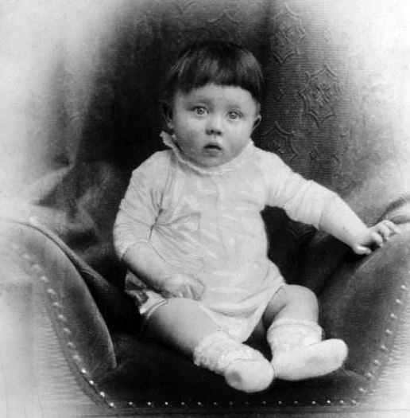
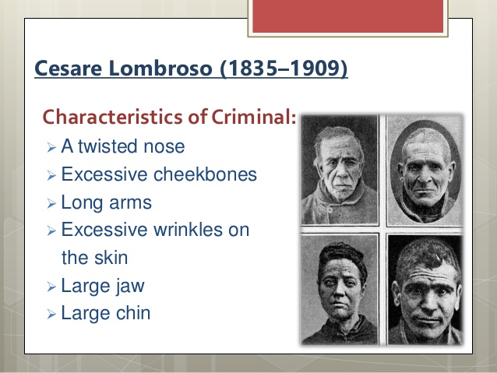

What makes someone a criminal?
Characteristics of a criminal
Crime scene to courtroom

Slide 5
What are the careers/progression pathways?
This course is the equivalent to an A level and the same amount of UCAS points.
Further study:
BSc Criminology
LLB (Hons) Law
Apprenticeships
Careers:
The criminal justice system
Social work
Civil service
Counselling
Teaching
Charities
Public services

Slide 6
What are the entry requirements?
To be able to study criminology:
You need to have 5 or more GCSE grades 9 to 4, including grade 4 or above in English.

