Slide 1



Slide 2
What is Health & Social Care?
Health and social care is the treatment of ill health and medical conditions in hospitals, health centres and in the community.
Social care is the care and support of vulnerable people, usually in the community.

Slide 3
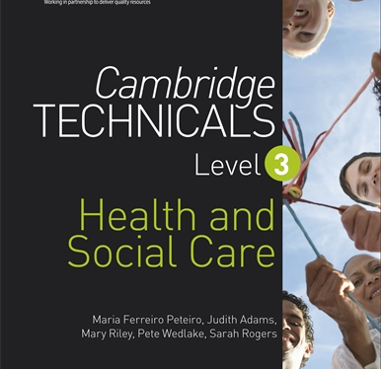
The Course
OCR Level 3 Extended Certificate in Health & Social Care
Equivalent to A-Level

Slide 4

Entry Requirements

Slide 5


Year 12 Units
Unit 1: Building Positive relationships in Health and Social Care
Unit 2: Equality, Diversity and Rights
Unit 3: Health & Safety in Health and Social Care

Slide 6


Year 13 Units
Unit 4: Anatomy and Physiology
Unit 10: Nutritional Health
Unit 14: The impact of long term physiological conditions

Slide 7
Course Structure
Coursework
Exam
50% coursework
Unit 1: Building Positive Relationships in Health and Social Care
Unit 10: Nutritional Health
Unit 14: The impact of long-term Physiological conditions
50% Exam
You can sit the exam up to 3 times
Unit 2: Equality and Diversity
Unit 3: Health and Safety
Unit 4: Anatomy & Physiology

Slide 8
Jobs/Pathways
Adult Nurse
Care Worker
Social Worker
Occupational Therapist
Mental Health Nurse
Physiotherapist
Paramedic
Midwife
Children’s Nurse

Slide 9
Why choose Health & Social Care?
Job Satisfaction - You could work with lots of different people, for example someone with a physical/learning disability, autism, dementia, or help someone recover from an accident. You can make a massive difference to someone’s life which is very rewarding.
In demand in the UK- The sector needs to find enough people to fill an extra half a million jobs by 2030 to meet the growing demand for adult social care services.
A job for life - On the flip side, health and social care jobs are jobs that can last a lifetime. There are such wide and diverse fields to get involved in, and the opportunities for advancement are nearly endless

Slide 10
Your Teachers
Mrs Begum
Mrs Brown

Slide 11
Any Questions please email rbegum@nottinghamacademy.org tbrown@nottinghamacademy.org

