Slide 1
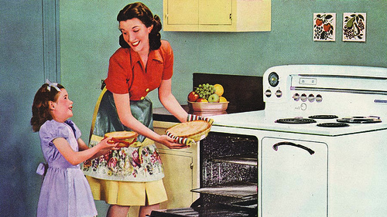

Welcome to Sociology
Mrs Brown & Mrs Gray

Slide 2

What is ‘Sociology’ about?
Sociology is about societal structures, what role and purpose social institutions such as the family, education and the criminal justice system plays in society.
It is about exploring topics that will develop your ability to think critically about the world around you and factors that influence social groups.
It is a thinking subject that will be challenging but worth it -
I promise!

Slide 3
Course Structure
Year 1
Units:
  Family and households
  Education with
  Research methods
  September 2021 -2022
Year 2
Units:
  Beliefs in society
  Crime and deviance
  with Theory and
  methods
  September 2022-2023
All of the units are
100% Exam
3 X 2 hour exams in June 2023
Entry Requirements
Level 5 or above in English

Slide 4


What career choices will studying
SOCIOLOGY give you?
Criminology
Market research
Academic research
Advertising
Politics
Probation
Social policy planning
Teaching
Social Work
Media
Journalism
Law
Human resources… and lots more!
Police

Slide 5

Watch/ listen to the following:
Watch this video to find out more about functionalism:
https://www.youtube.com/watch?v=-83vVeSC2_g
Watch this video and find out more about Marxism: https://www.youtube.com/watch?v=fSQgCy_iIcc
Watch this video to find out more about feminism: https://www.youtube.com/watch?v=D6Dl-9pSW-4
Read the following:
Diane Reay - explaining the unequal treatment of working class children in education https://www.theguardian.com/education/2017/nov/21/english-class-system-shaped-in-schools
Why is there still a housework inequality gap? Read the article
https://www.theguardian.com/inequality/2018/feb/17/dirty-secret-why-housework-gender-gap
Be observers, be thinkers…
Of the game

Slide 6

If you have any question please email me
tbrown@nottinghamacademy.org
Thank you for listening!

