Slide 1
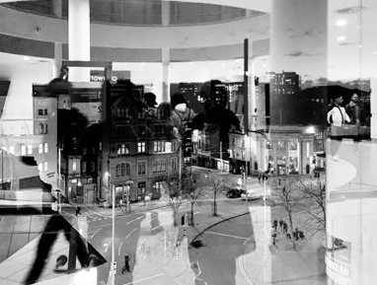

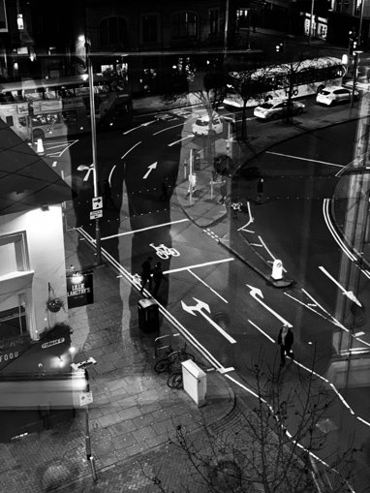

PHOTOGRAPHY A Level
​
Do you want to develop your photographic skills?​
Do you enjoy thinking for yourself?​
Do you enjoy learning new techniques?​
Do you like developing your own original ideas?

Slide 2
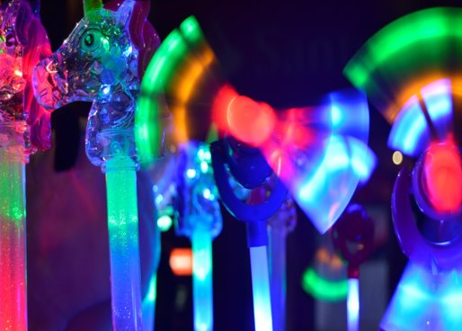
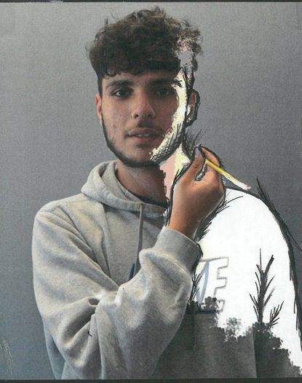
A Level Photography is a lens-based and light-based media. Students can select from a range of study areas within photography including portraiture, landscape or still life photography and documentary photography.​
​

Slide 3
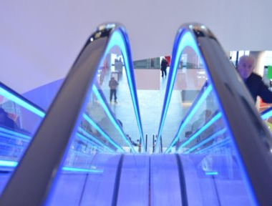
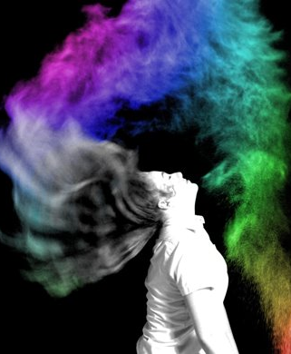
Then you will work on a given theme of your own choice and will be able to explore, develop and experiment with your ideas to create a body of work.​
You will submit a portfolio of all your work at the end of Year 13 with one major project and an examination unit.
Assessment:​
Unit 1 60% - set and marked by school. Moderated by AQA​
Unit 2 40% - externally set. Marked by school. Moderated by AQA.
In Year 12 the projects are skills based to begin with and you will learn how to produce work using a wide variety of techniques and methods.​

Slide 4
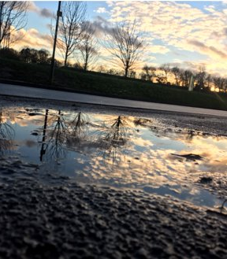
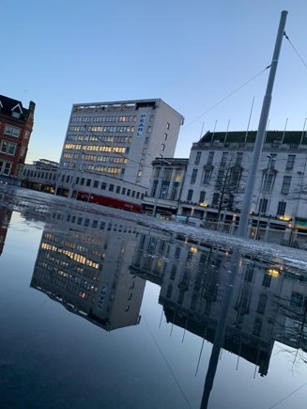
Coursework consists of a one major projects which can be based on a variety of subjects such as:​
​
Portraiture ​
Landscape ​
Still Life photography ​
Documentary photography​
Issues
Movement
Texture
​
The examination unit is also practical. Students respond to their chosen theme based on a examination booklet.
Question papers can be issued to students from 2nd February in the year of the examination.

Slide 5
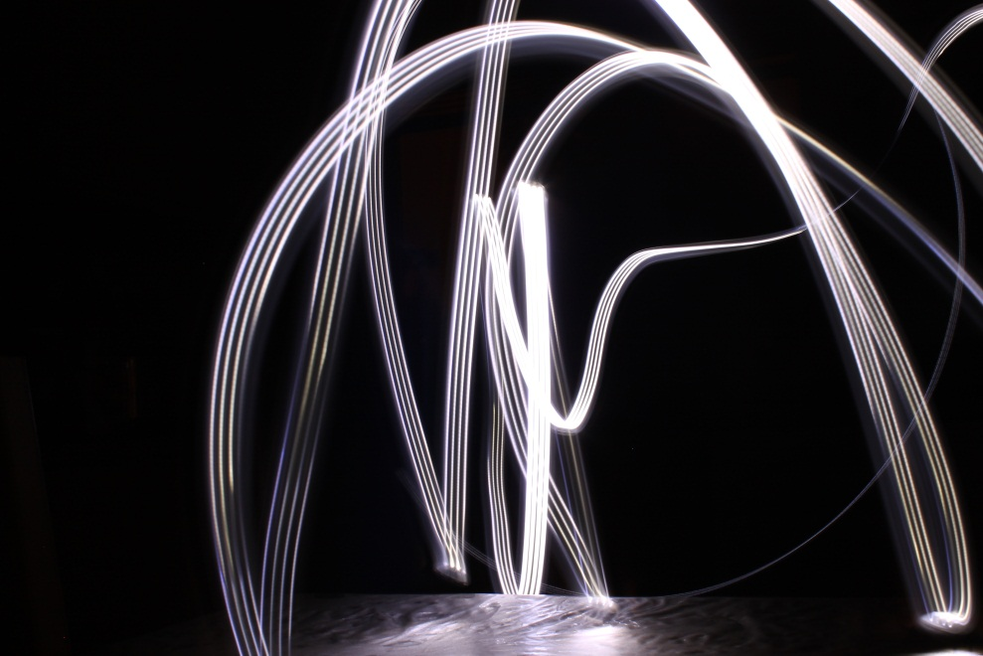
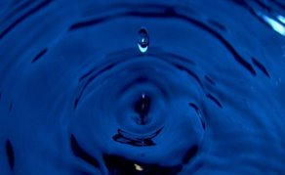
You will also use a wide range of media such as:​
Digital SLR /Manual SLR​
ICT development​
Studio photographing​
Darkroom printing​
​
A level Photography is not just for students who can take photographs, but for anyone who enjoys being creative and experimenting with original ideas and new technologies.
Career paths:
Photographer
Fashion industry
Film/video editor
Graphic designer
Magazine feature editor
Press photographer
Medical illustrator
Advertising art director

Slide 6

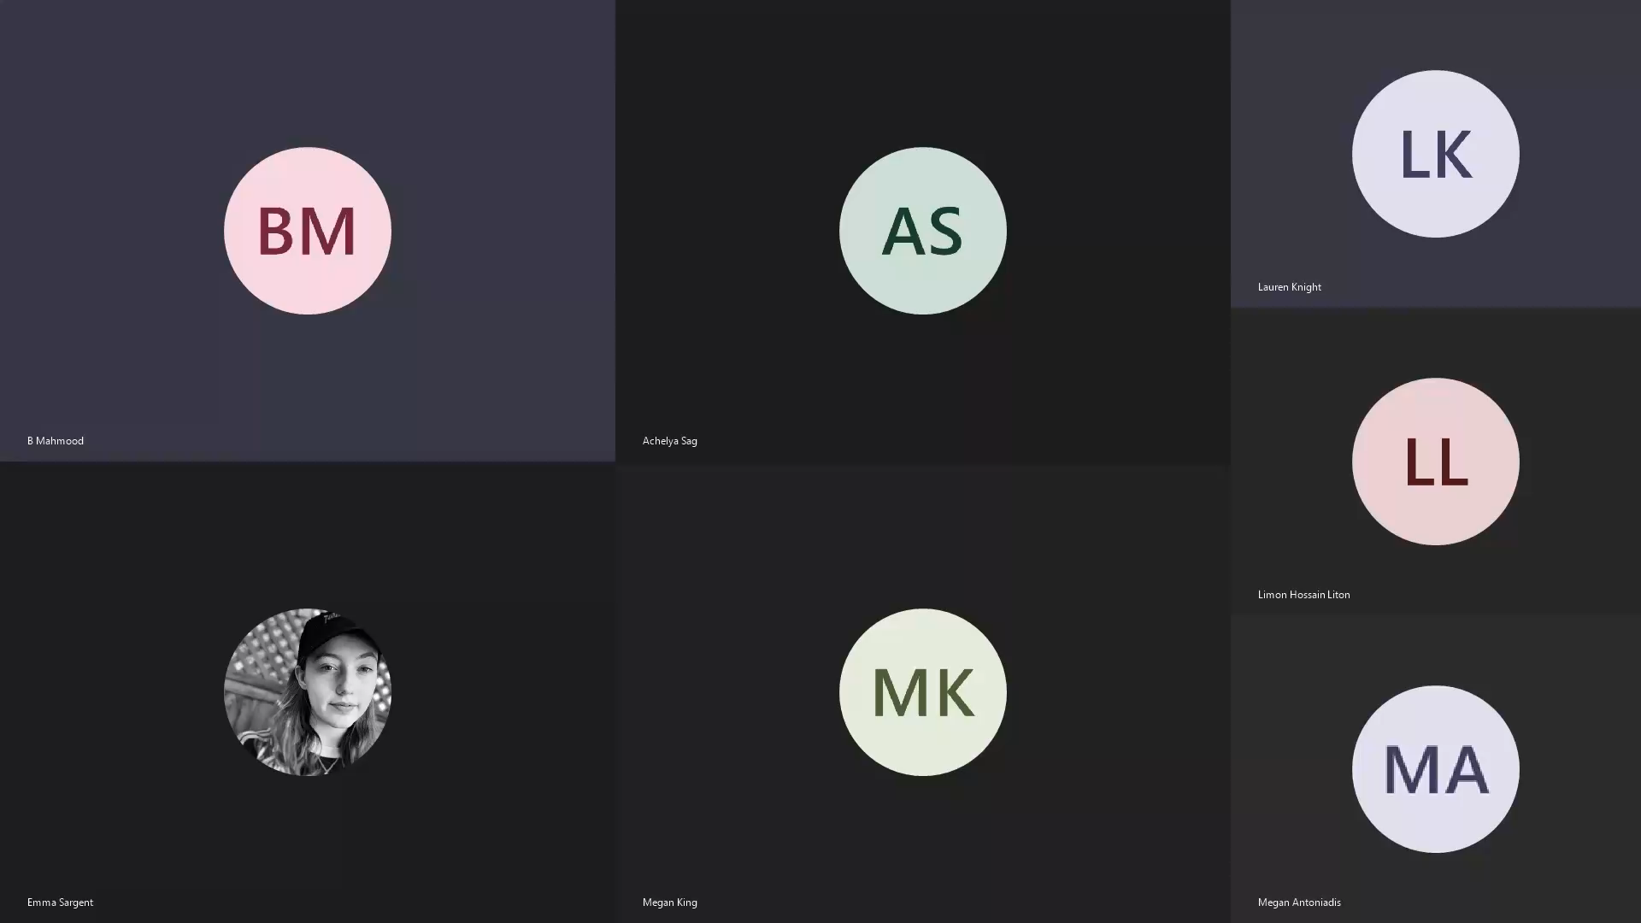
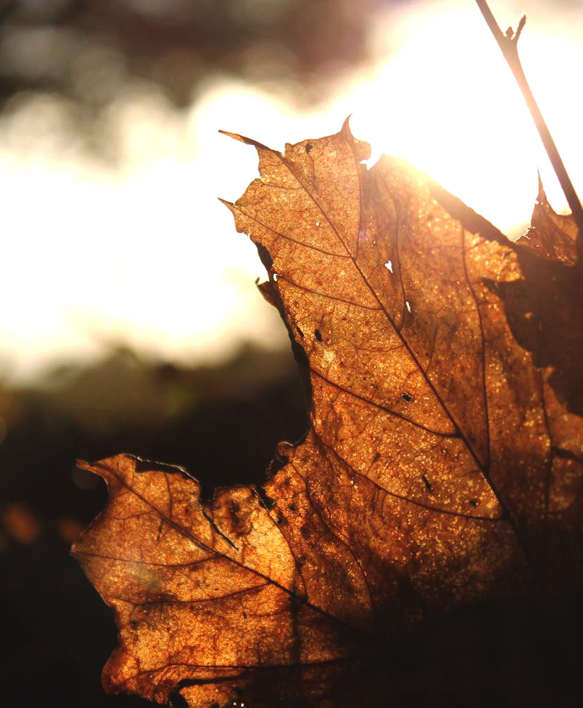
What students think about Photography?
Your art teachers will help you with your decision.​
​
Please see a member of the art team for more information.

