Slide 1
Languages
NOTTINGHAM ACADEMY
SIXTH FORM
Community Languages

Slide 2
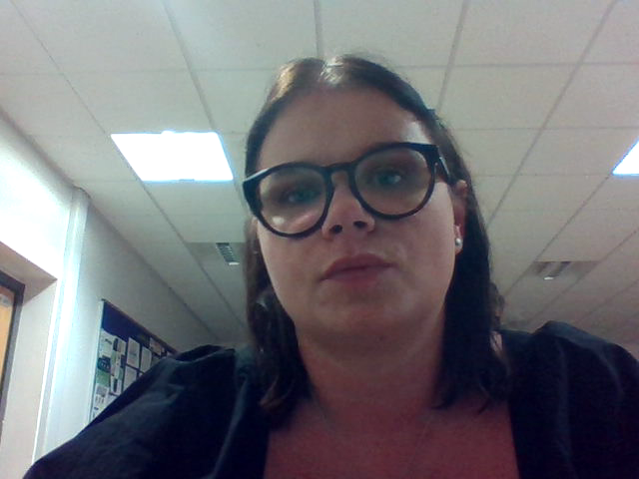
Community Language
Entry Requirements:
Native Speaker of your language
Languages Available:
Portuguese
Italian
Turkish
Persian
Bengali
Russian
German
Mandarin Chinese
Polish
Panjabi

