Slide 1
Welcome to
A Level
Religious Studies
Why choose
Religious Studies
A level?

Slide 2
Religion has been a fundamental part of life. As people look into the vastness of space or witness the miracle of birth, they contemplate the meaning of life and their own mortality.

Slide 3
It’s for you
Religious Studies is designed for people of any faith... and people who have no faith.
You don’t need GCSE RS, just a desire to find out more about religion and its role in society.

Slide 4

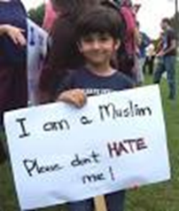

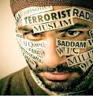
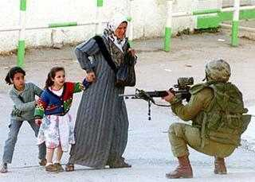
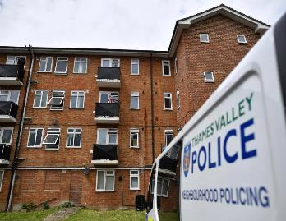
Religion, especially Islam is always in the news…
Muslim Ban

Slide 5

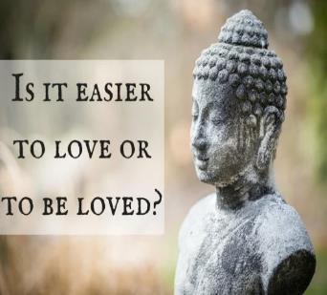
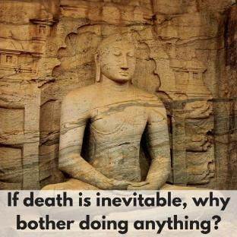
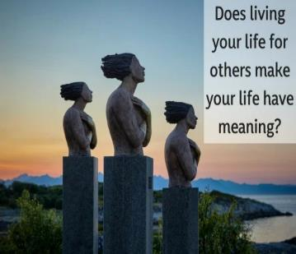
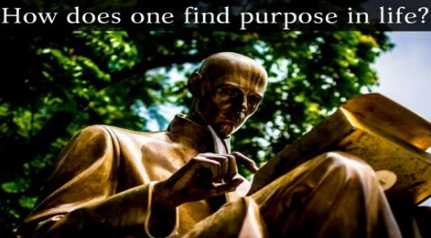

Everyone wants to know the answers to the big philosophical questions of life….

Slide 6

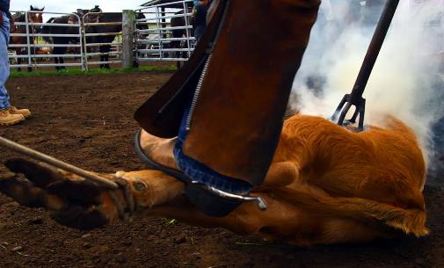
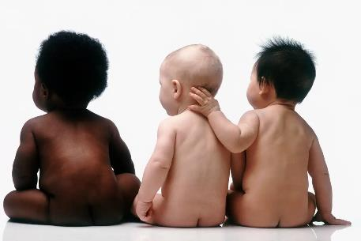


We are all concerned about the big ethical issues of life
Should we give other animals rights?
Should we make everyone normal?
Should we save the earth from ourselves?
Should we make euthanasia legal?

Slide 7

The study of Religious Studies is fundamental to breaking down barriers that divide.

Slide 8
The course will cover 4 Units, you choose 3:
Philosophy
Ethics
Islam or
New Testament

Slide 9
Unit 1: Philosophy of Religion
This covers:
Design argument, Cosmological argument, Ontological argument, Religious Experience & The Problem of Evil & Suffering

Slide 10


Is our world designed?
Is there a cause
of everything?

Slide 11
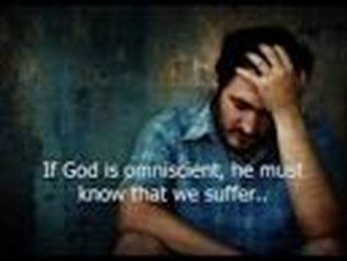
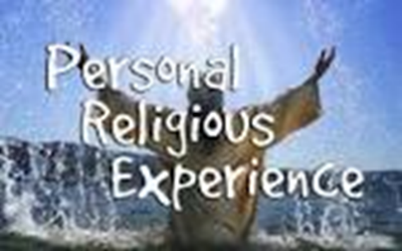

Religious experience
Can evil & suffering
be justified??

Slide 12
Area 2: Ethics
This covers:
Ethical theories, equality, environmental ethics, sexual ethics & medical ethics.

Slide 13

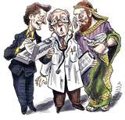
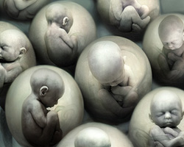

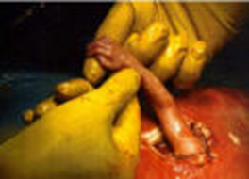
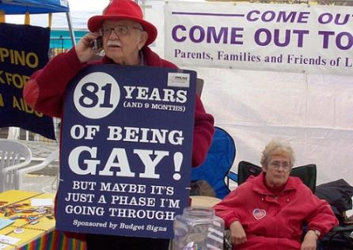
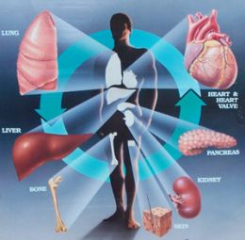

Medical Ethics
Morality - What is right and wrong in life? How do we know?
Euthanasia
Human Cloning
Abortion
Sexual Ethics
Organ Transplantation
Stem Cell
Research

Slide 14


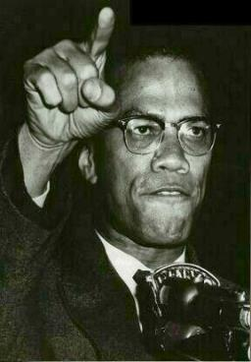

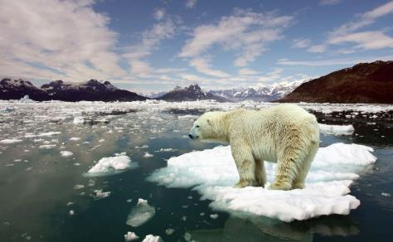
Environmental ethics & equality

Slide 15
Area 3: Islam
This covers:
An in depth study of Islam.
Pre-Islamic Arabia,
life of Muhammad (pbuh)
6 Beliefs/5 pillars
How the Qur’an was formed/written
Period of the Rightly Guided Caliphs
Sunni & Shi’a Islam
Jihad

Slide 16

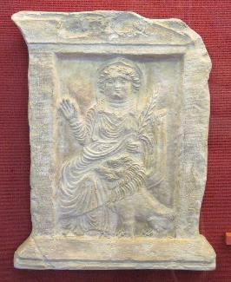
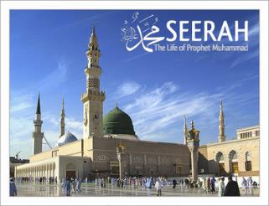
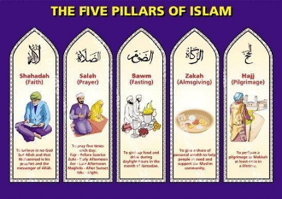
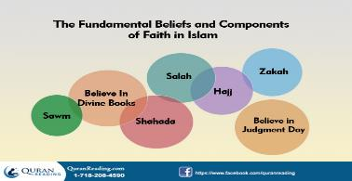
Beliefs & practices of Arabs before Islam
Goddess Allāt, one of the three patron gods of the city of Makkha
Life of the Prophet (pbuh)
Detailed analysis of beliefs and practices according to scholars

Slide 17
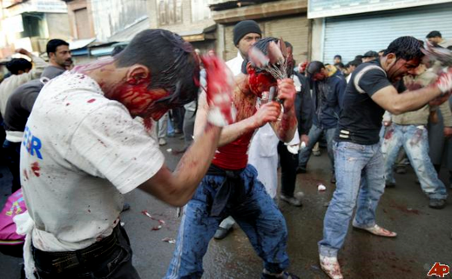



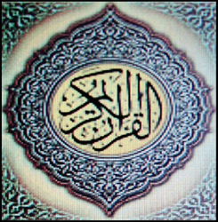
Differences between Sunni & Shi’a Muslims
Who wrote the Qur’an?
Who are the Sufis?

Slide 18
Area 4: New Testament Studies
This covers:
Social, Historical, and Religious context of the Life of Jesus.
Interpreting the text and issues of relationship.

Slide 19
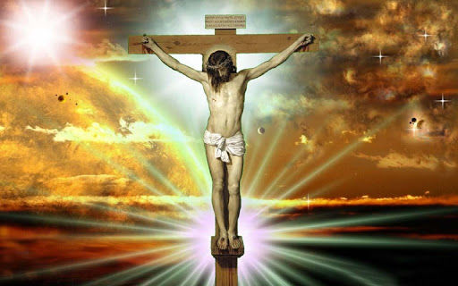
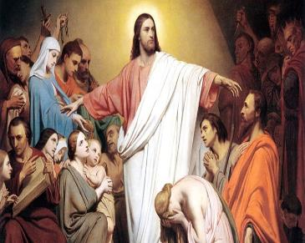
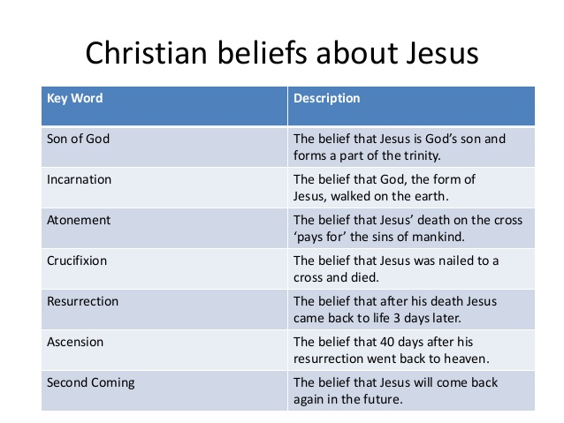

The Life of Jesus

Slide 20
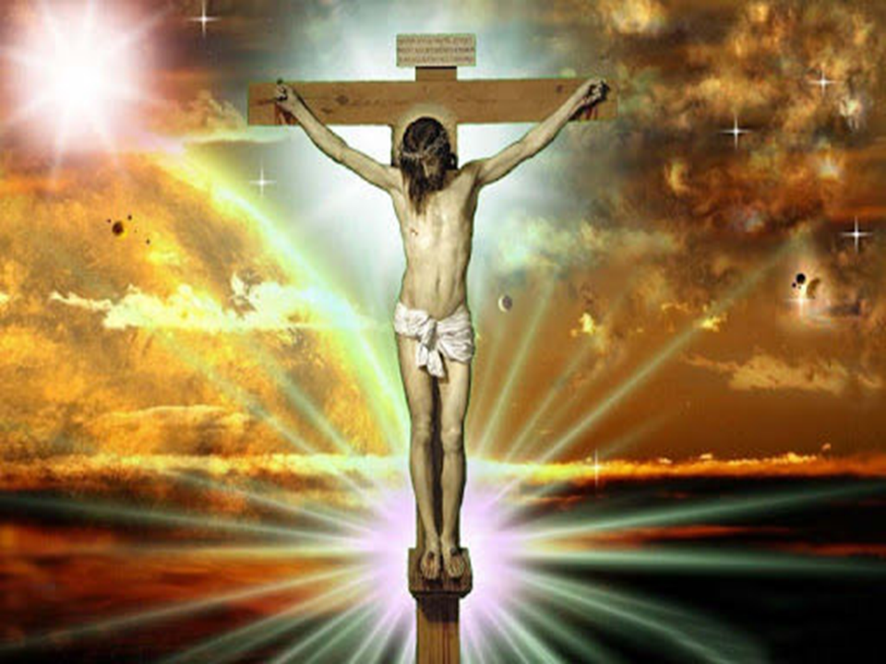
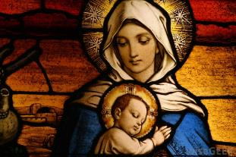
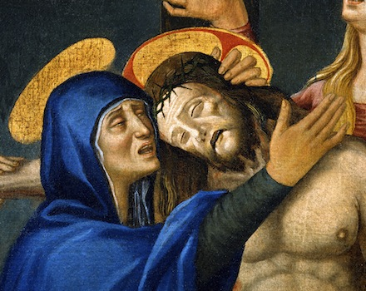
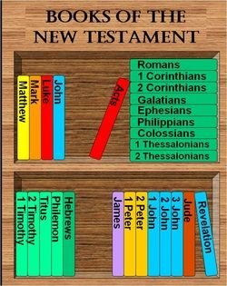
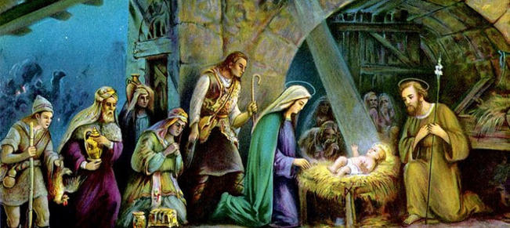

Slide 21
How will I be assessed?
End of year 2 you will be examined in 3 papers
1: Philosophy: 2 hours (33.3%)
2: Ethics: 2 hours (33.3%)
3: Islam: 2 hours (33.3%) OR
4: New Testament: 2 hours (33.3%)

Slide 22
2019 examination results
A* | A | B | C | D | E | U
 | 1 | 3 | 3 | 1 | 2 | 0
RS is one of the highest performing subjects

Slide 23
What skills do I need?
You do not have to study RS at GCSE to take it at A Level.
Be Interested, have a positive attitude.
Join
in discussions
Prepare to work hard
Be Organised
Ask controversial questions
Be respectful

Slide 24
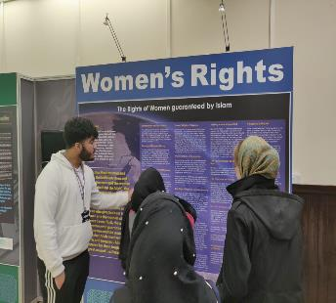
Helped me get to university
student's views
Breaks down barriers and misconceptions
Even though I am Muslim, this course taught me a lot about other religions
Highly recommended!!!
Brilliant!!
Learnt useful life skills such essay writing
It opened my eyes because I learnt about myself

Slide 25
What careers can Religious Studies lead to?
Packed with CULTURE CAPITAL
Teaching/Lecturing
Medicine/nursing
Counselling
Social work
Law
Business and Management
Accountancy
Banking
Police Force/Armed Forces
Media
…and many more.
It is a very academic subject and highly respected by all universities and employers.
They will be impressed you studied this subject!

Slide 26
What do I do next?
Talk to Ms T Khan in A142
Meet year 12/13 students
Tick either Philosophy, ethics, Islam
or Philosophy, ethics, New Testament
in the option blocks

Slide 27
You'll be glad
you chose
Religious Studies

