Slide 1



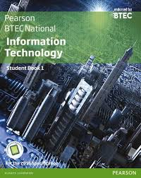



Level 3 BTEC National Extended Certificate in Information Technology
Mr Taurins
Mr Hussain

Slide 2


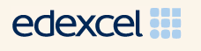
Course offered: BTEC Level 3 Extended Certificate in Information Technology
Length of course: 2 Years
Specification: Edexcel
Number of lessons per week: 5 lessons a week
Entry qualifications: GCSE Mathematics Grade 4, and GCSE English Grade 4.
WHY CHOOSE IT BTEC?
The BTEC Level 3 National Extended Certificate in Information Technology is intended as an applied general qualification covering 360 GLH (Guided Learning Hours) and equivalent in size to one A Level.
It is designed for learners who are interested in an introduction to the study of creating IT and computer systems to manage and share information alongside other fields of study, with a view to progressing to a wide range of higher education courses, not necessarily in IT.

Slide 3
Course offered: BTEC Level 3 Extended Certificate in Information Technology
Length of course: 2 Years
Specification: Edexcel
Number of lessons per week: 5 lessons a week
Entry qualifications: GCSE Mathematics Grade 4, and GCSE English Grade 4.
AIMS OF THE COURSE
You will develop a common core of IT knowledge and study areas such as the relationship between hardware and software that form an IT system, managing and processing data to support business and using IT to communicate and share information.
This BTEC qualification is a 2 Year course and students apply learning through a range of practical assessments.
The combination of practical and written assessment styles will give you the confidence to apply your knowledge to succeed in the workplace – and have the study skills to continue learning on higher education courses (if you choose to), and throughout your career.

Slide 4
Course offered: BTEC Level 3 Extended Certificate in Information Technology
Length of course: 2 Years
Specification: Edexcel
Number of lessons per week: 5 lessons a week
Entry qualifications: GCSE Mathematics Grade 4, and GCSE English Grade 4.
SKILLS & KNOWLEDGE
All BTEC Nationals provide transferable knowledge and skills that prepare learners for progression to university. The transferable skills that universities value include:
The ability to learn independently
The ability to research actively and methodically
Being able to give presentations and being active group members.

Slide 5
Course offered: BTEC Level 3 Extended Certificate in Information Technology
Length of course: 2 Years
Specification: Edexcel
Number of lessons per week: 5 lessons a week
Entry qualifications: GCSE Mathematics Grade 4, and GCSE English Grade 4.
LEARNING STYLES
The BTEC course requires students to be well motivated, organised and independent learners who enjoy an active learning approach.
We use a range of different teaching methods and you will be helped to identify your own learning style preferences and to make use of these to help you succeed.
You will be expected to develop independent thinking and study skills. You will use a wide variety of software applications and produce coursework in different formats such as multimedia presentations, web pages, written reports and posters.
Students who prefer to demonstrate ability and expertise through practical coursework and ongoing assessment should enjoy the rigour and structure of the course.

Slide 6
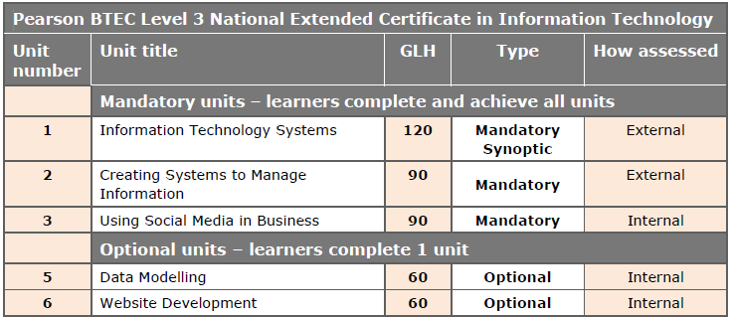
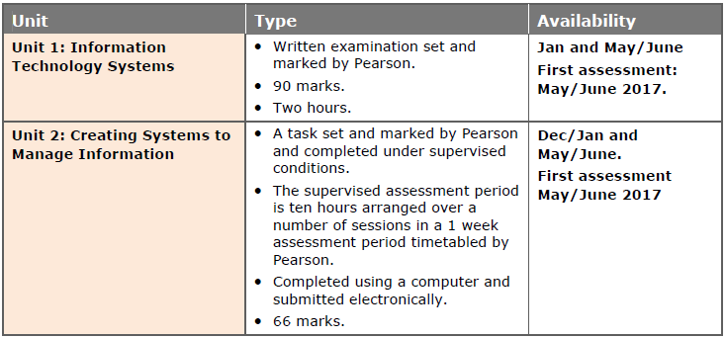
Course offered: BTEC Level 3 Extended Certificate in Information Technology
Length of course: 2 Years
Specification: Edexcel
Number of lessons per week: 5 lessons a week
Entry qualifications: GCSE Mathematics Grade 4, and GCSE English Grade 4.
CORE UNITS FOR THIS COURSE INCLUDE:
Unit 1: Information Technology Systems (synoptic) (External Exam)
Unit 2: Creating Systems to Manage Information (External – Practical Exam)
Unit 3: Using Social Media in Business (Coursework Assignment)
OPTIONAL UNITS FOR THIS COURSE INCLUDE:
Unit 5: Data Modelling(Coursework Assignment)
OR:
Unit 6: Website Development (Coursework Assignment)

Slide 7
Course offered: BTEC Level 3 Extended Certificate in Information Technology
Length of course: 2 Years
Specification: Edexcel
Number of lessons per week: 5 lessons a week
Entry qualifications: GCSE Mathematics Grade 4, and GCSE English Grade 4.
HOW DOES THE QUALIFICATION PROVIDE EMPLOYABILITY SKILLS?
In the BTEC National units there are opportunities during the teaching and learning phase to give learners practice in developing employability skills.
Cognitive and problem-solving skills: use critical thinking, approach non-routine problems applying expert and creative solutions, use systems and technology
Intrapersonal skills: communicating, working collaboratively, negotiating and influencing, self-presentation
Interpersonal skills: self-management, adaptability and resilience, self-monitoring and development.
Notes:
The BTEC Level 3 Extended Certificate in Information Technology will provide you with the opportunity to develop you cognitive and problem solving skills, you will develop an understanding of project management techniques and the importance of effective communication and working collaboratively. In essence you will develop the skills that will enable you to succeed in either academia or the world of work.

Slide 8
Course offered: BTEC Level 3 Extended Certificate in Information Technology
Length of course: 2 Years
Specification: Edexcel
Number of lessons per week: 5 lessons a week
Entry qualifications: GCSE Mathematics Grade 4, and GCSE English Grade 4.
SUBJECT COMBINATIONS AND PROGRESSION
Information Technology combines well with many other subjects and the choice will largely be determined by the longer-term aim of the student.
The BTEC Extended Certificate gives students a choice of progression options. Students who successfully complete the qualification will be well equipped to move onto degree programs, Higher National Diplomas or relevant employment.
POTENTIAL CAREERS
Database administrator, Animator, Graphic designer, Illustrator, IT technical support officer, Network engineer, Systems analyst, Systems developer, Office administrator

