Slide 1
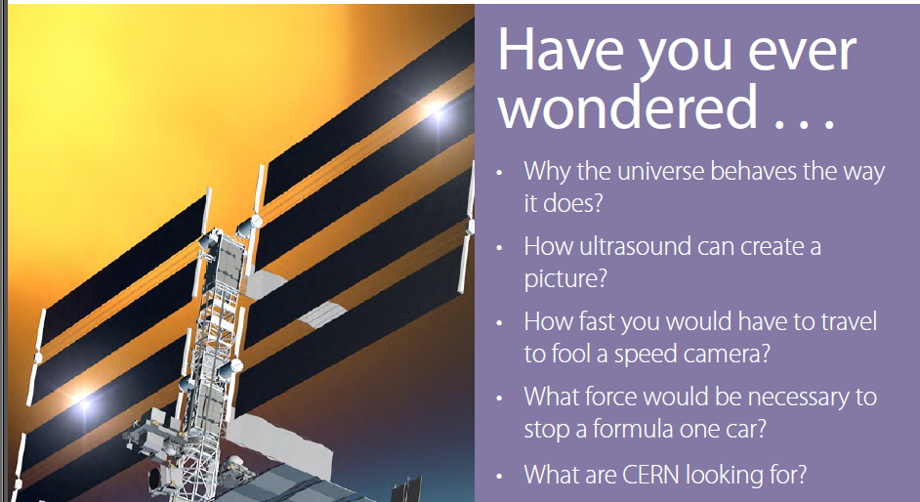

Slide 2
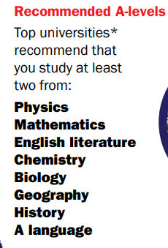

Why choose physics
If you don’t know what you want to do, think about the A-levels that will keep the most options open. Top universities recommend that you take at least two of the subjects shown opposite. For most science and engineering courses both A-level physics and maths are required.

Slide 3
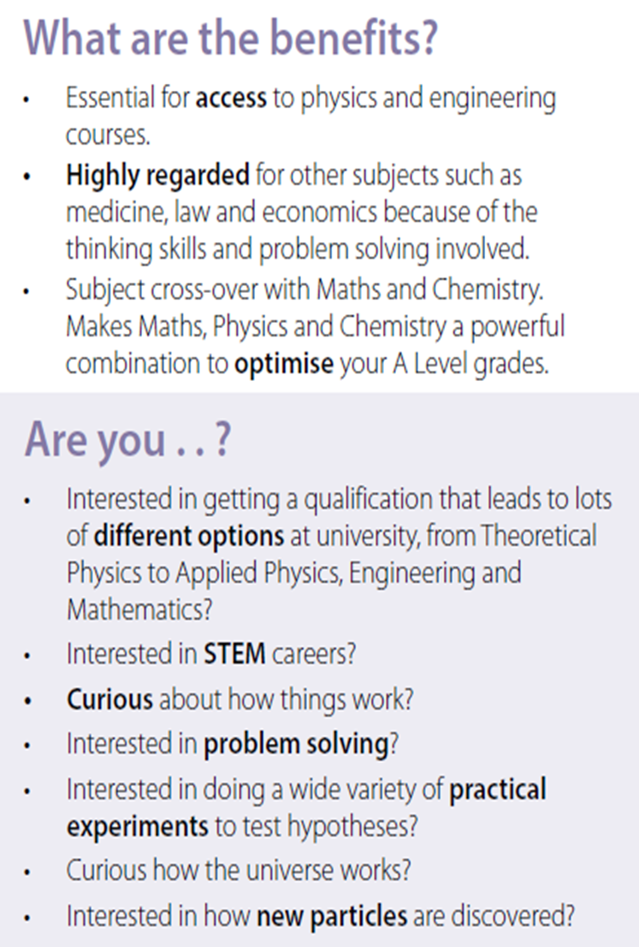

Why study Physics

Slide 4
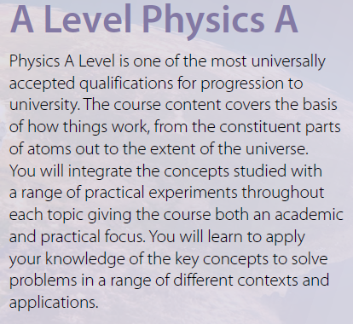



Slide 5
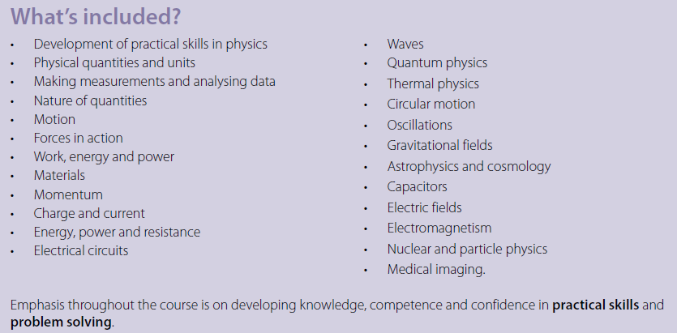



Slide 6
Requirements to study A level Physics
Grade 6 in Maths and Science/Physics
Grade 5 English

Slide 7
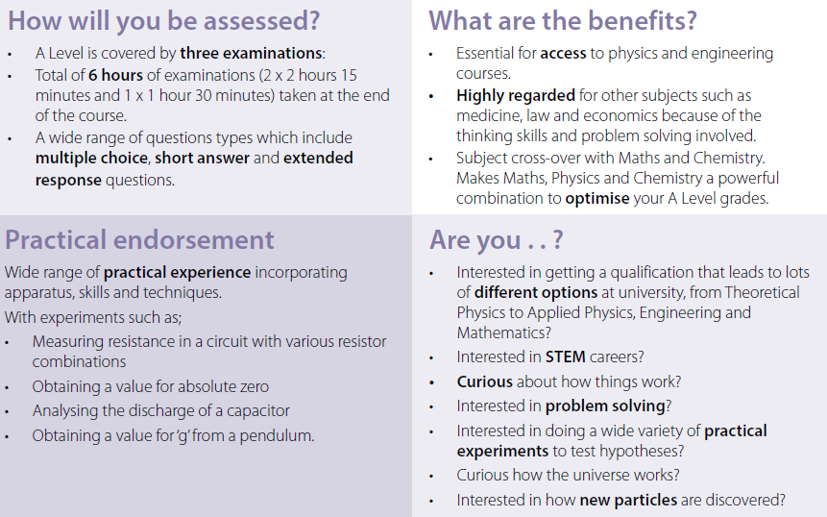



Slide 8
Average starting salary £23,131
Aeronautical and Manufacturing Engineering £26,736
Civil Engineering £26,729
Electrical and Electronic Engineering £27,659
General Engineering £28,649
Mathematics £26,415
Mechanical Engineering £26,937
Physics and Astronomy £26,731
Medicine £30,636
Economics £28,287

Slide 9


STEPH
TV WEATHER FORECASTER
“To get any job you have to stand out from the crowd. Physics will help to give you that edge; people are always impressed by a qualification in physics.”

Slide 10
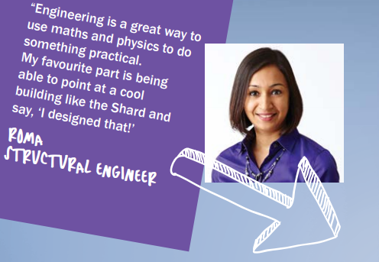
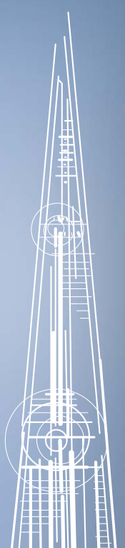
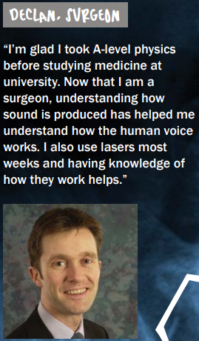

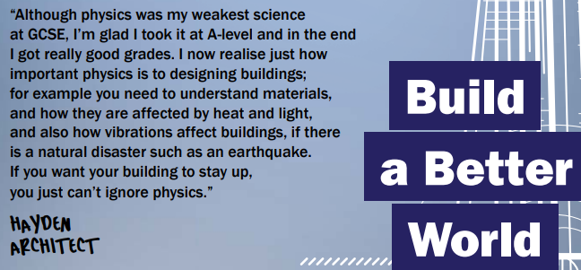
jobs

Slide 11

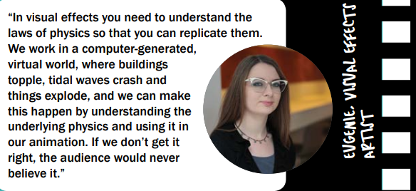


Slide 12



